Slide 1
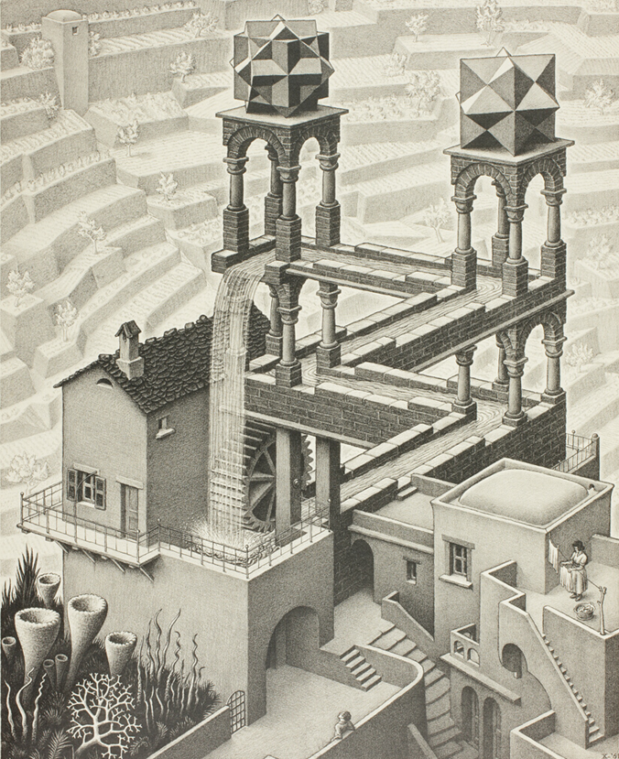

From linear to circular
IL “Introduction to Circular Economy” WS 24-25
Kami Höferl
(Escher, 1961)

Slide 2
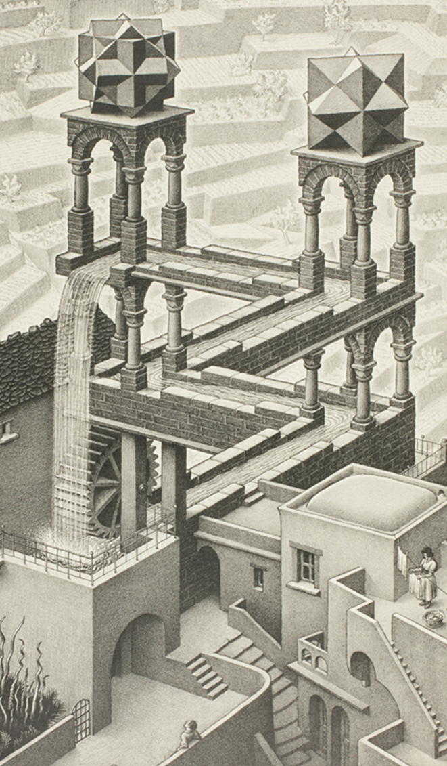
Overview
Me & my phone
Defining Circular Development (Rrrrrrr!)
Again my phone
(Escher, 1961)
(Escher, 1961)

Slide 3
Circularity?

Slide 4
A) Associations with “Circular Business”
🤔

Slide 5
B) Associations with “Global Change”
🤔

Slide 6
Where we are now

Slide 7
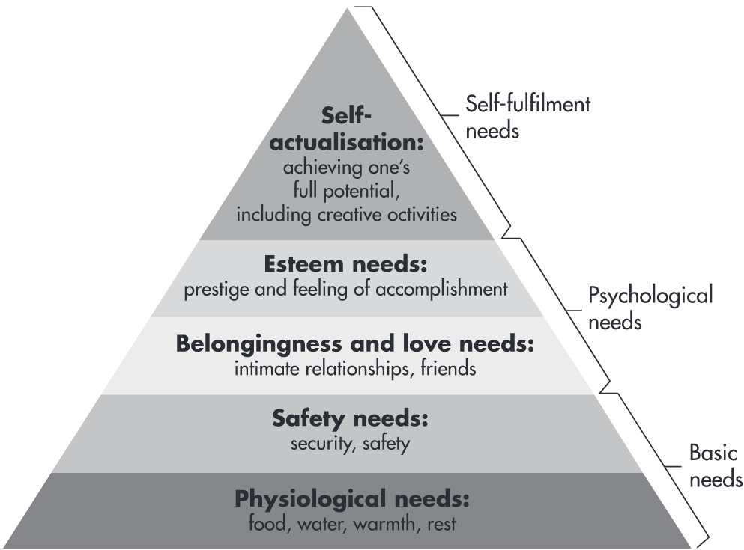



What is driving us:
Maslow's pyramid of needs (1943):
Deficiency needs:
More or less "clear" boundaries
Satisfiable
Growth needs:
No limits "upwards"
👉 not finally satisfiable
Growth needs
Deficiency needs
WLAN
Battery

Slide 8
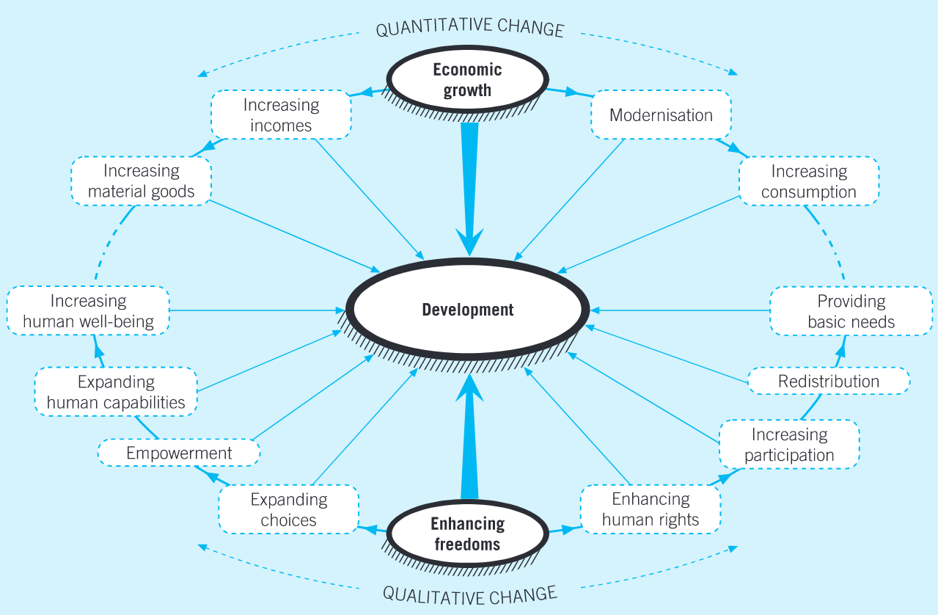
@ What development?
“Development” for:
material consumption through economic growth
human development by improving education, health & living standards

Slide 9
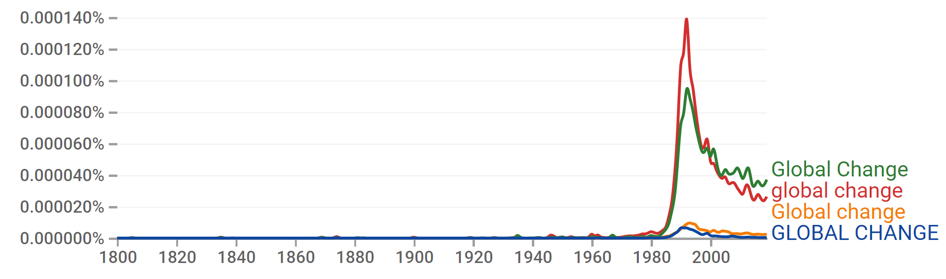
And what happened so far: Global Change

Slide 10
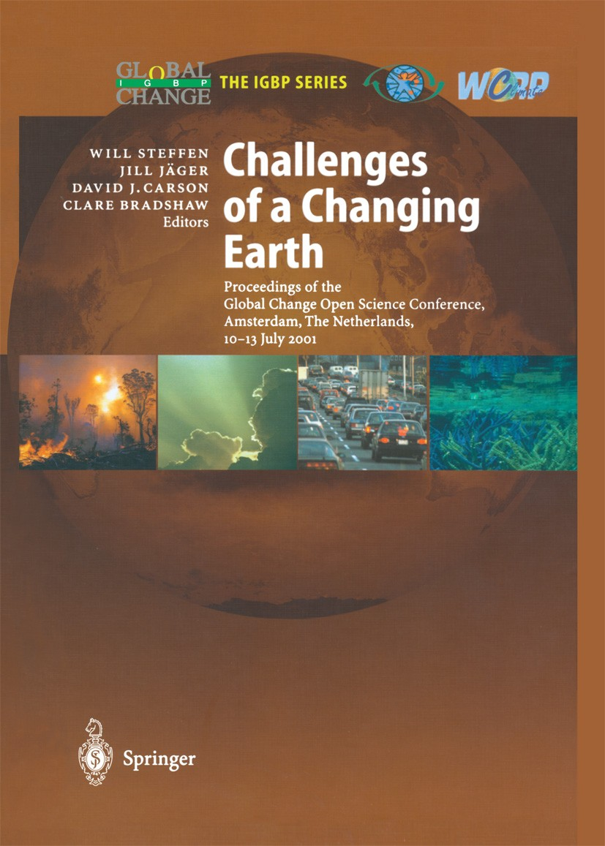
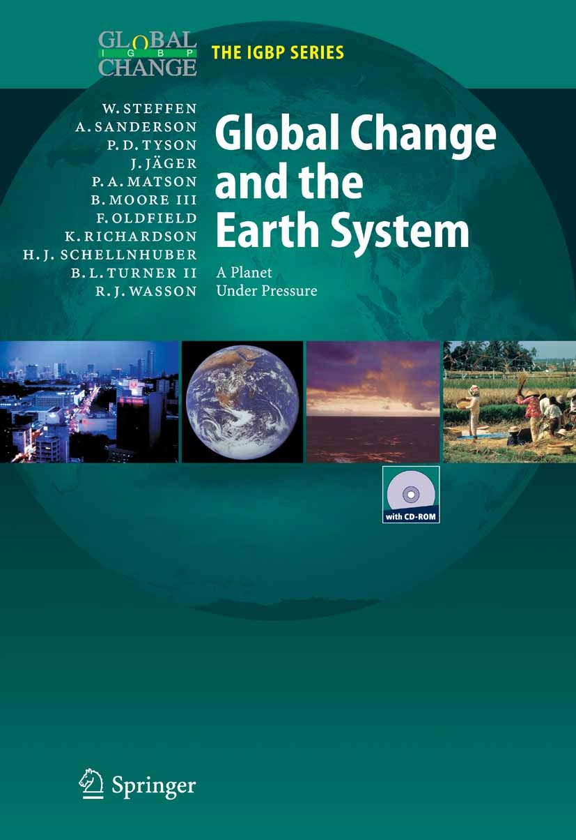
Global Change?

Slide 11
From 1990s on: Global Change is here!
2001: The Amsterdam Declaration on Global Change
"in addition to the threat of significant climate change, there is growing concern over the ever-increasing human modification of other aspects of the global environment and the consequent implications for human well-being. Basic goods and services supplied by the planetary life support system, such as food, water, clean air, and an environment conducive to human health are being affected increasingly by global change“ (Steffen et al., 2002:207)

Slide 12
From 1990s on: Global Change is here!
Steffen et al. (2002:207p.) findings:
The Earth System behaves as a single, self-regulating system comprised of physical, chemical, biological and human components.
Human activities are significantly influencing Earth’s environment in many ways in addition to greenhouse gas emissions and climate change
Earth System dynamics are characterised by critical thresholds and abrupt changes. Human activities could inadvertently trigger such changes with severe consequences for Earth’s environment and inhabitants.
In terms of some key environmental parameters, the Earth System has moved well outside the range of the natural variability exhibited over the last half million years at least.
Notes:
2001 Amsterdam conference UNDP

Slide 13
From 1990s on: Global Change is here!
Main conclusion from the Amsterdam Declaration on Global Change (2001):
👉 An ethical framework for global stewardship and strategies for Earth System management are urgently needed.
Notes:
2001 Amsterdam conference UNDP

Slide 14
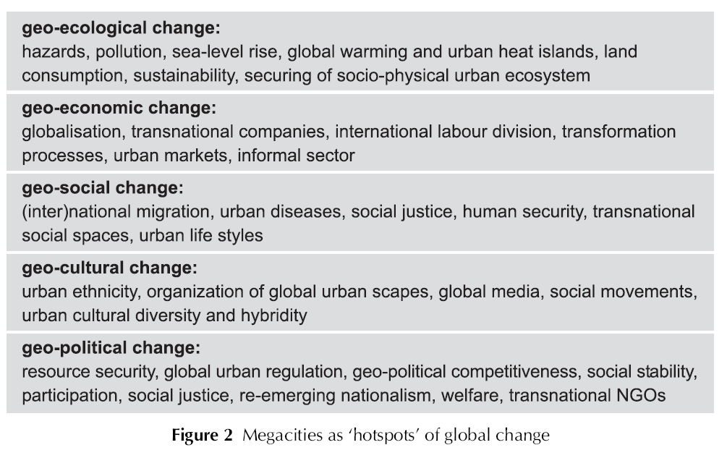
But what exactly is Global Change?
large-scale transformations affecting the Earth’s systems, including environmental, economic, social, and political shifts:

Slide 15
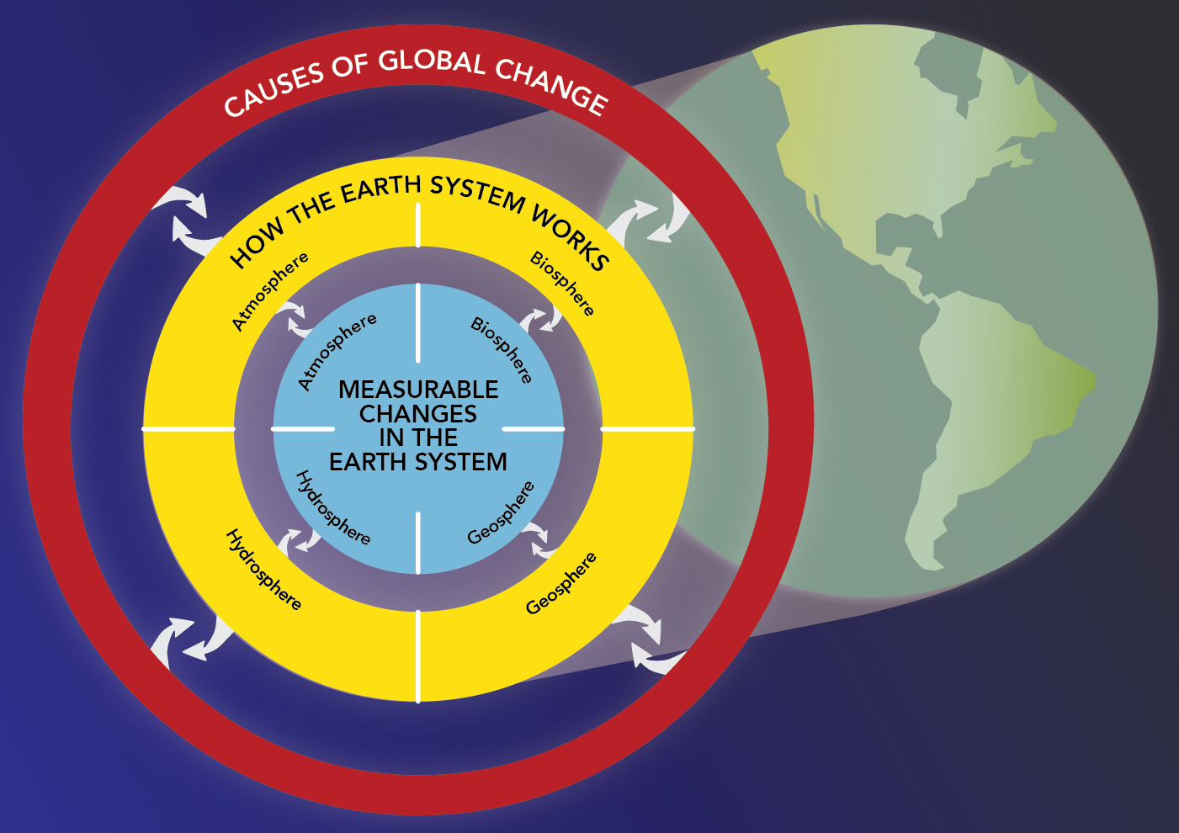
Who is causing these global shifts?

Slide 16
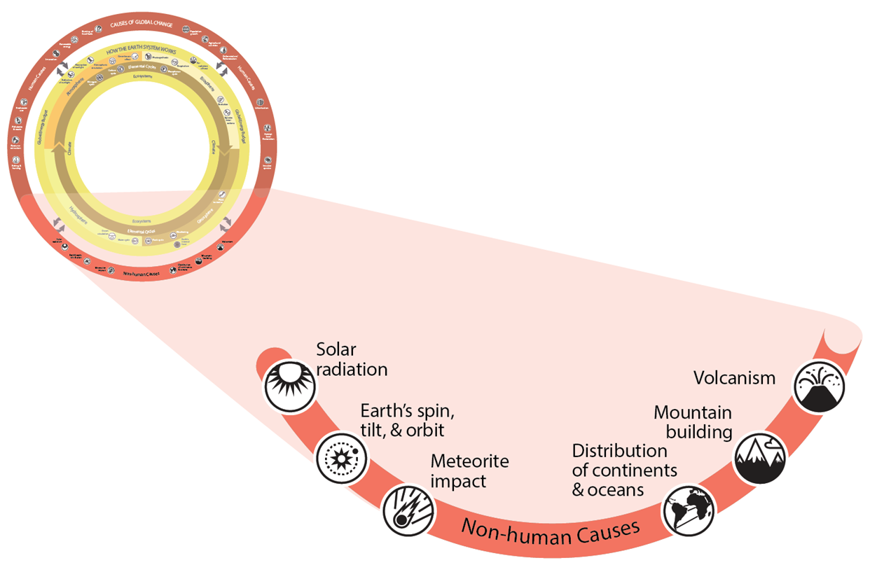
Non-human causes

Slide 17
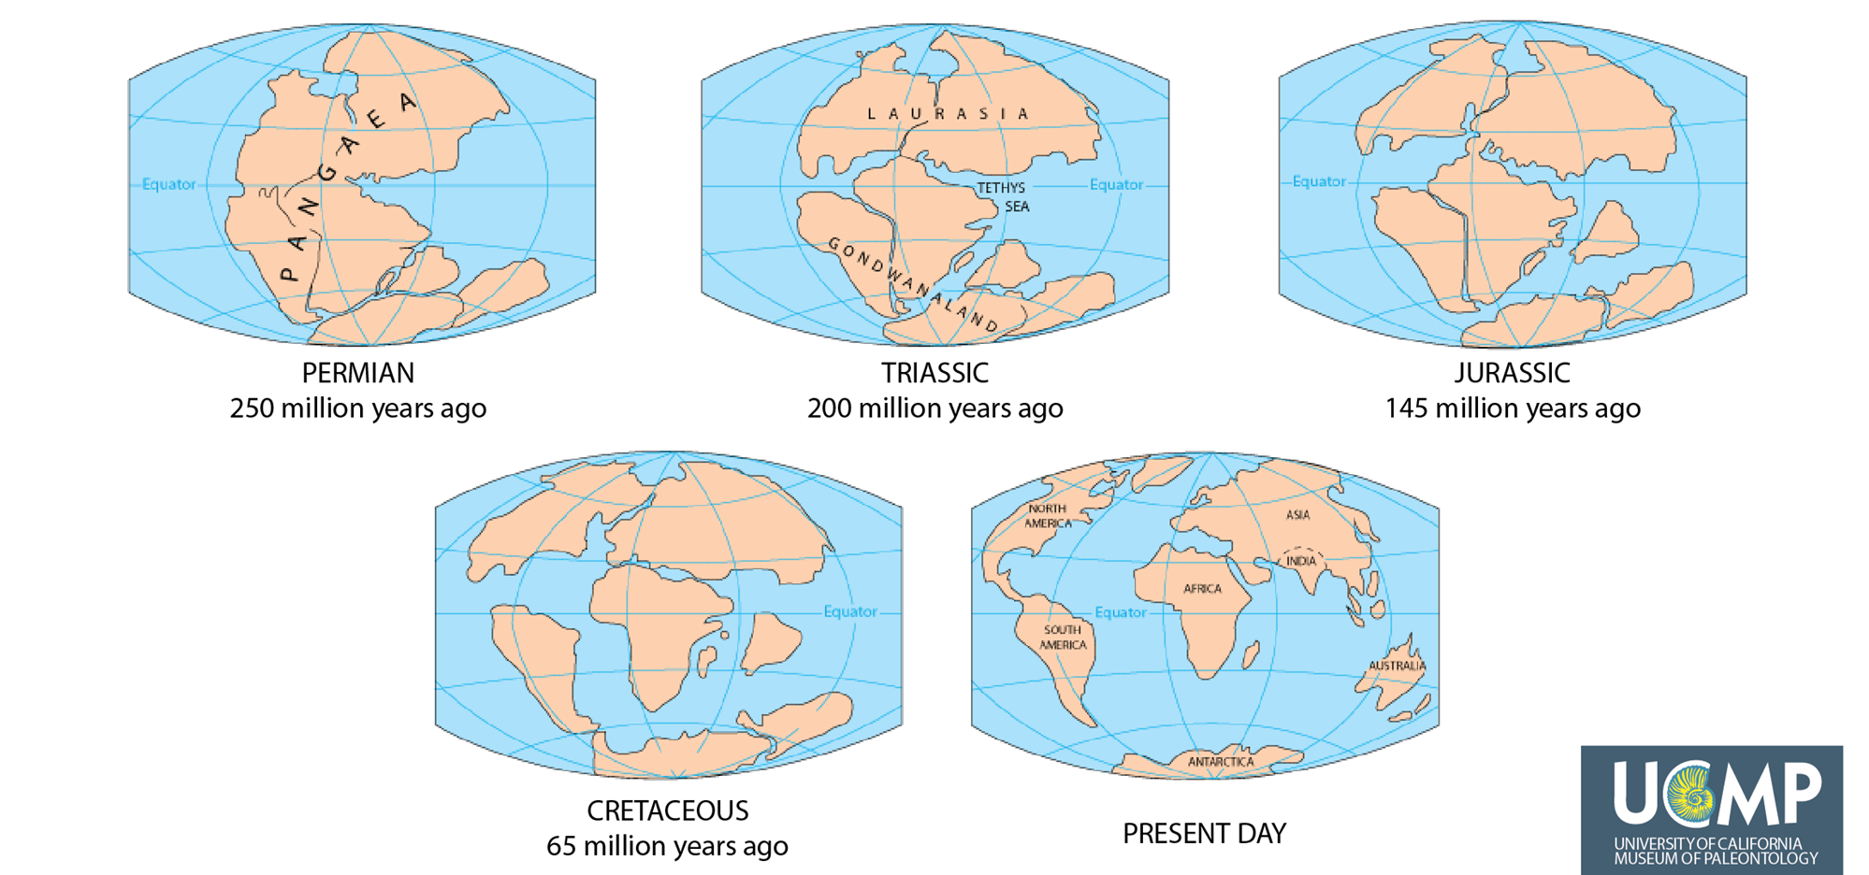
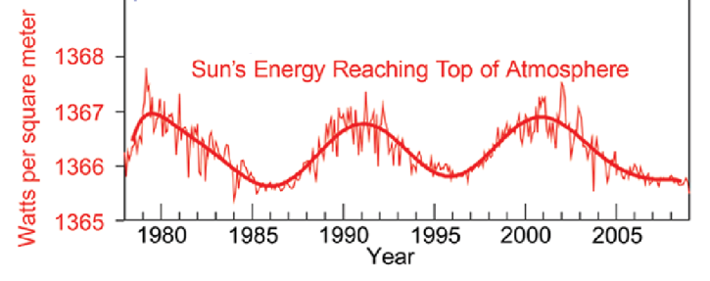

Non-human causes

Slide 18
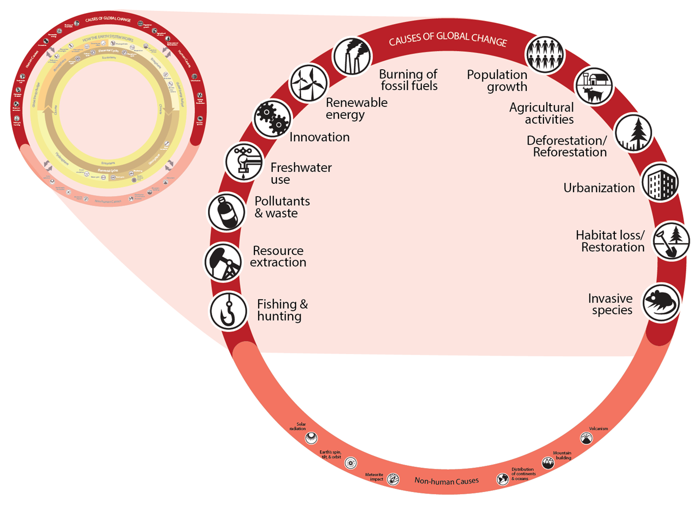
Human causes

Slide 19
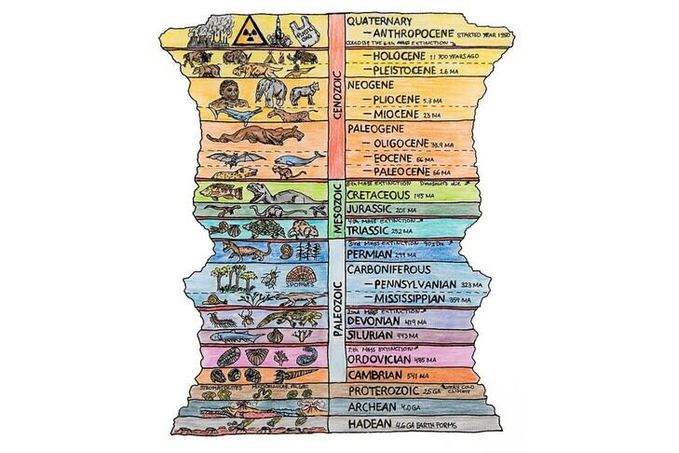
Global Change – but why?
Human activities = most volatile driving force since mid-20th century:
Population growth and increased resource consumption
Fossil fuel burning and greenhouse gas emissions
Land use changes and deforestation
Pollution and waste production
👉 Great Acceleration & Anthropocene
humanity as “geological force”

Slide 20
There has always been change …
Extent of acceleration
Scale of the extent
Spectrum of acute and simultaneous change processes
Significance and extent of human influence
👉 „It is this massive economic, political, social, cultural, and environmental change simultaneously burdening our lives that has persuaded so many that we do indeed live in ‚new times‘“ (Johnston et al.: 5)

Slide 21
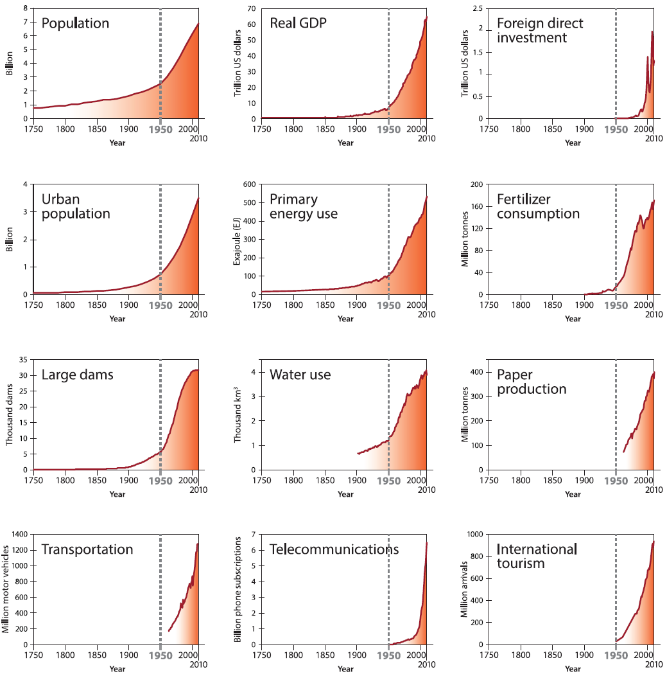
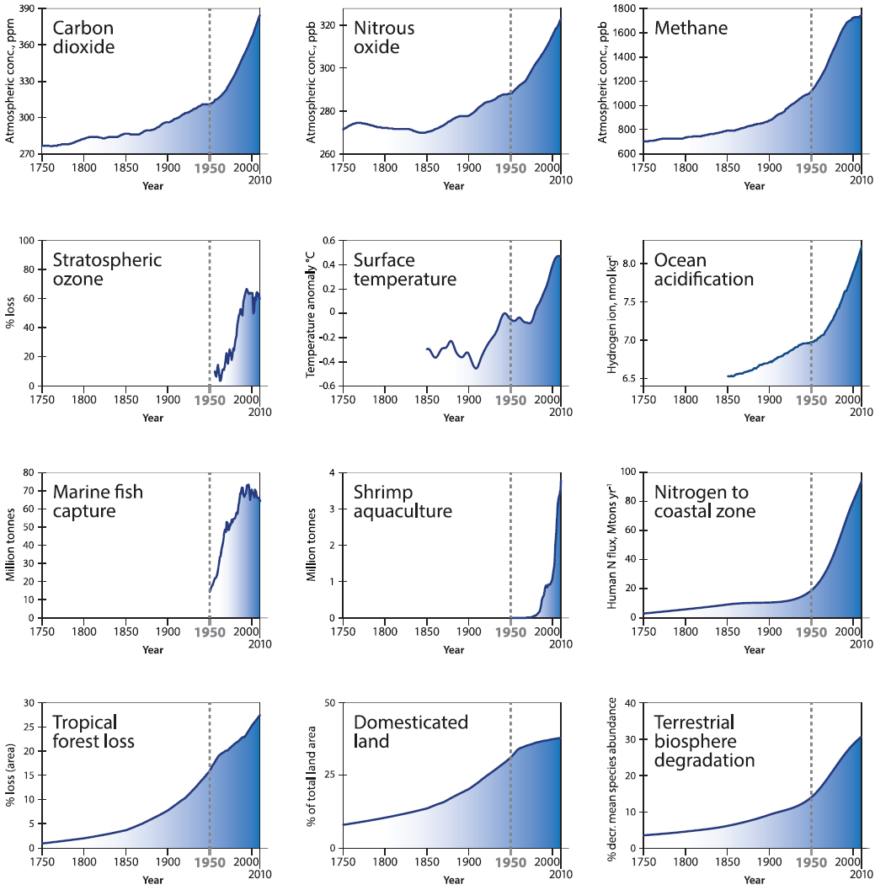
Great Acceleration: Steffen et al. (2015)

Slide 22
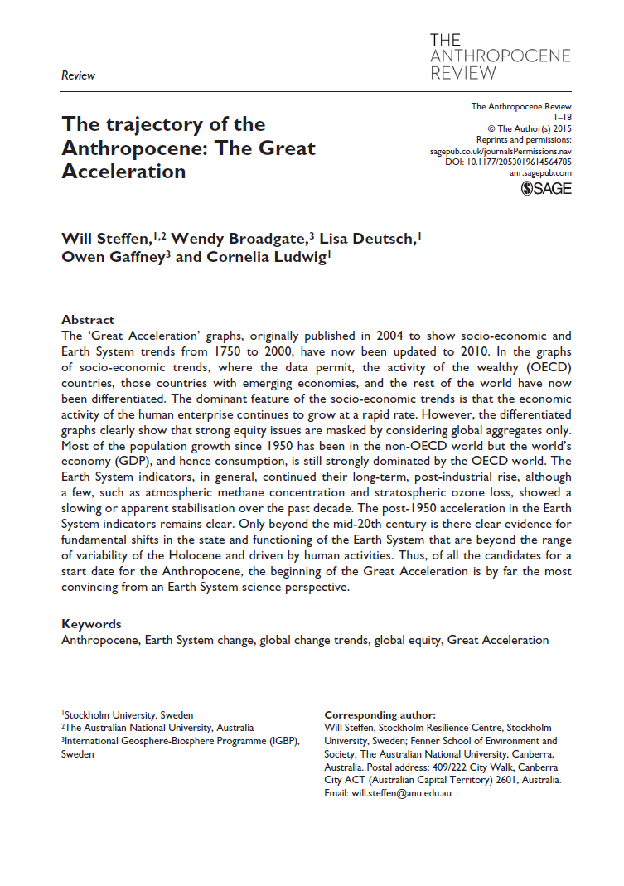
Great Acceleration: Steffen et al. (2015)

Slide 23
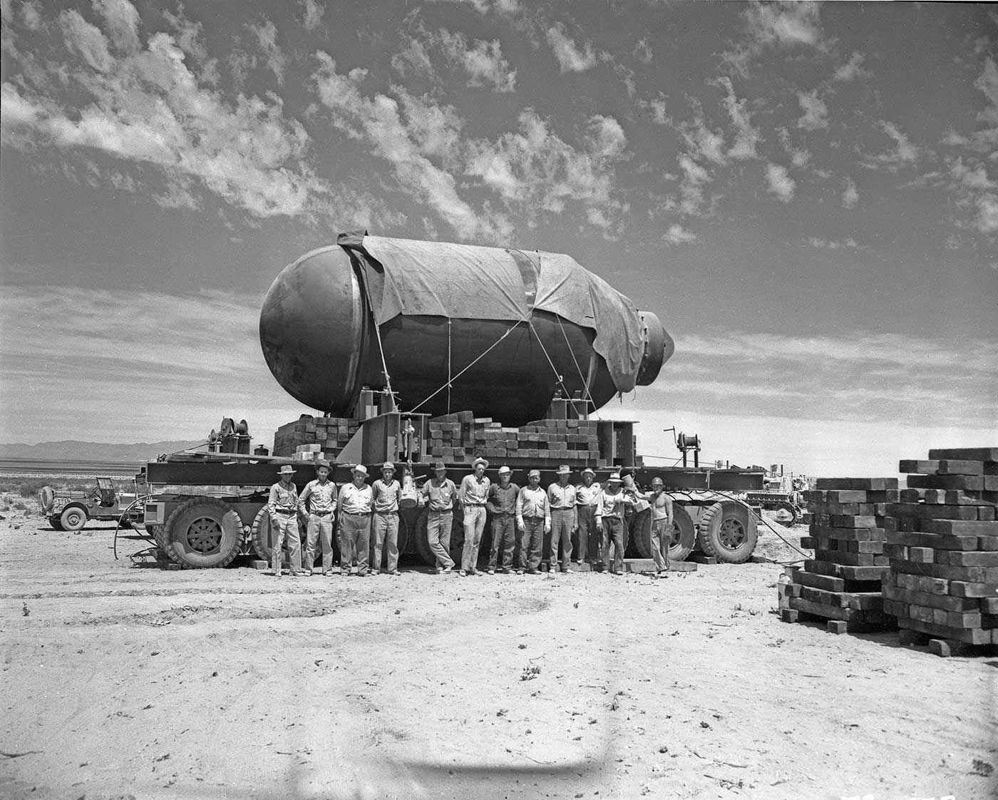
@ geological force
Notes:
Trintiy Test 1945 in White Sands Missile Range, New Mexico

Slide 24
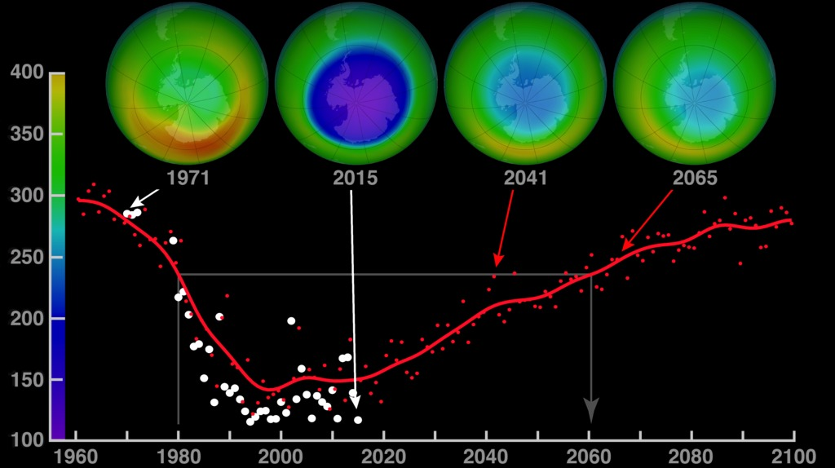
@ geological force
Notes:
Stratospheric ozone layer: 20 to 35 km height
Chlorofluorocarbons: chlorine-containing source gases

Slide 25
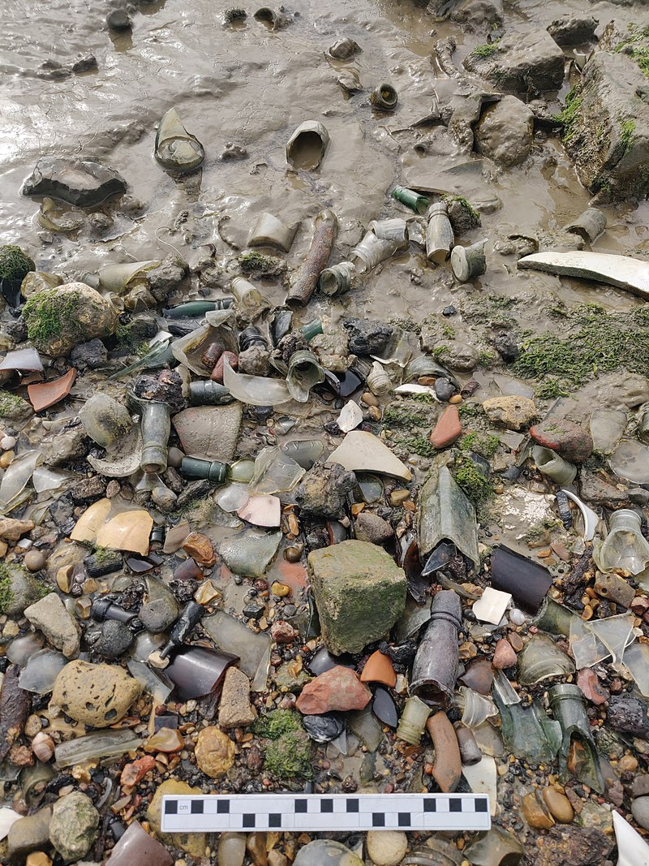
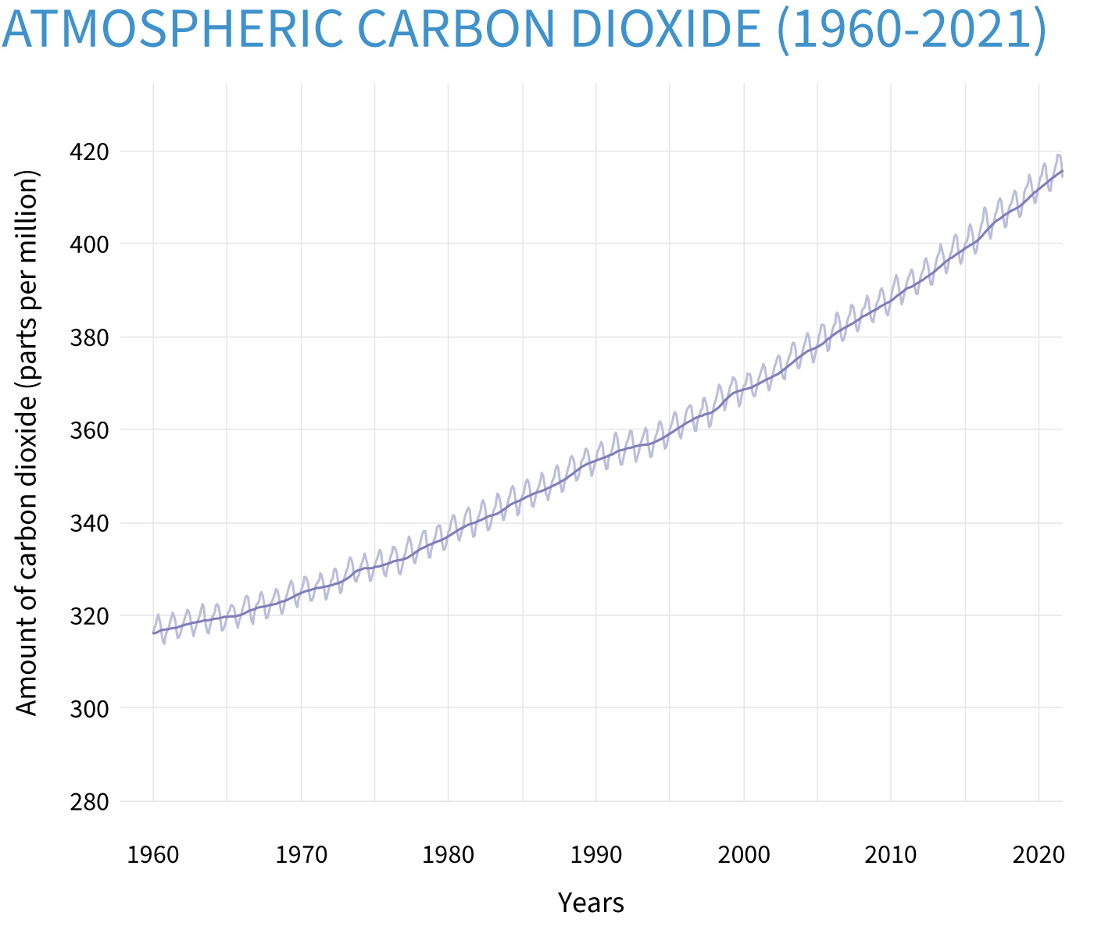
@ geological force
Notes:
Trintiy Test 1945 in White Sands Missile Range, New Mexico

Slide 26
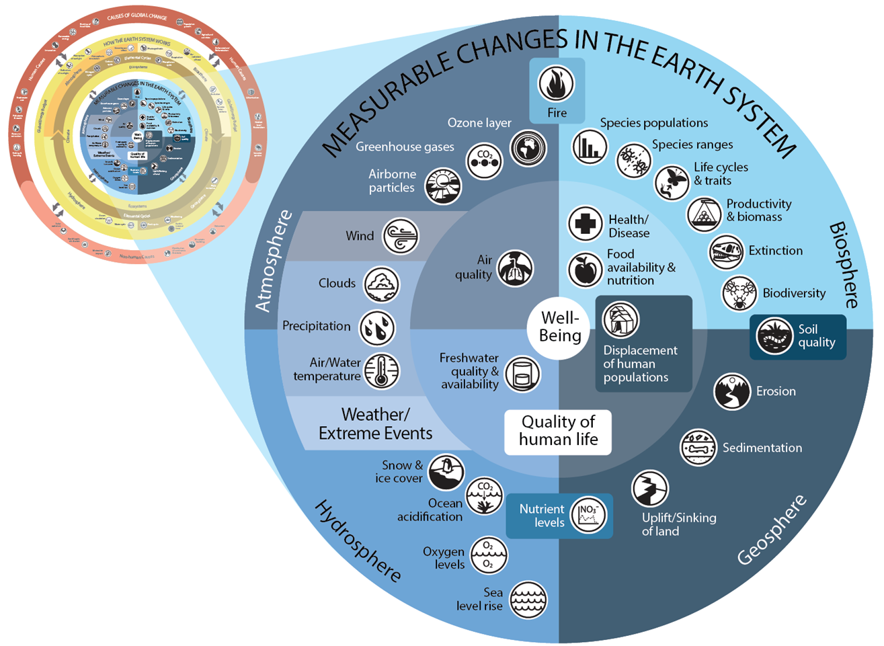
Our impacts

Slide 27
BREAK

Slide 28
How many are we?

Slide 29
Why demography?
🤔

Slide 30
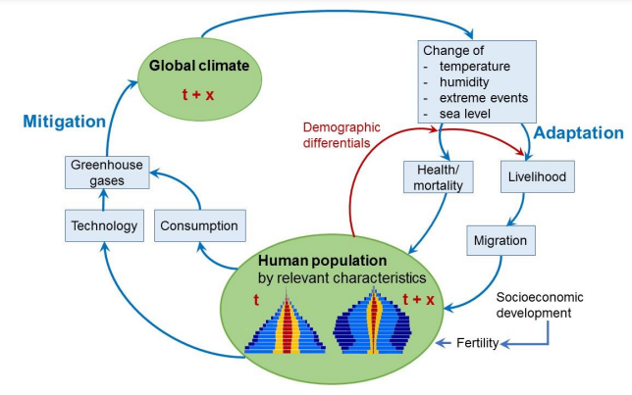
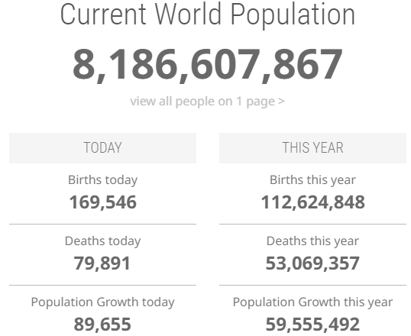
Why demography?

Slide 31
How many are we?

Slide 32
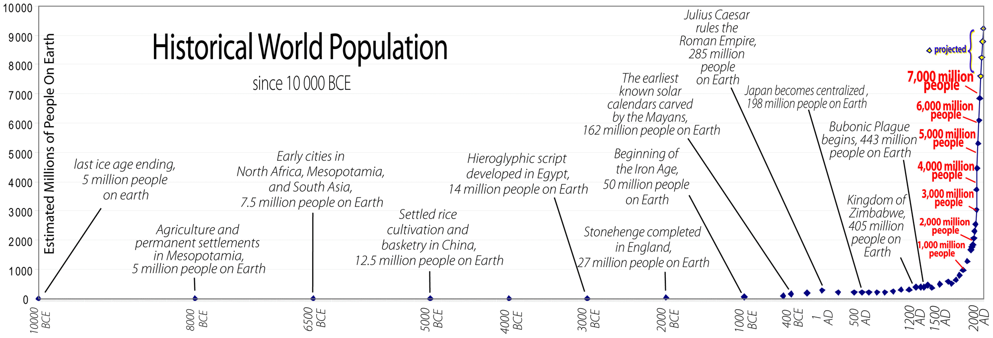
… and counting

Slide 33
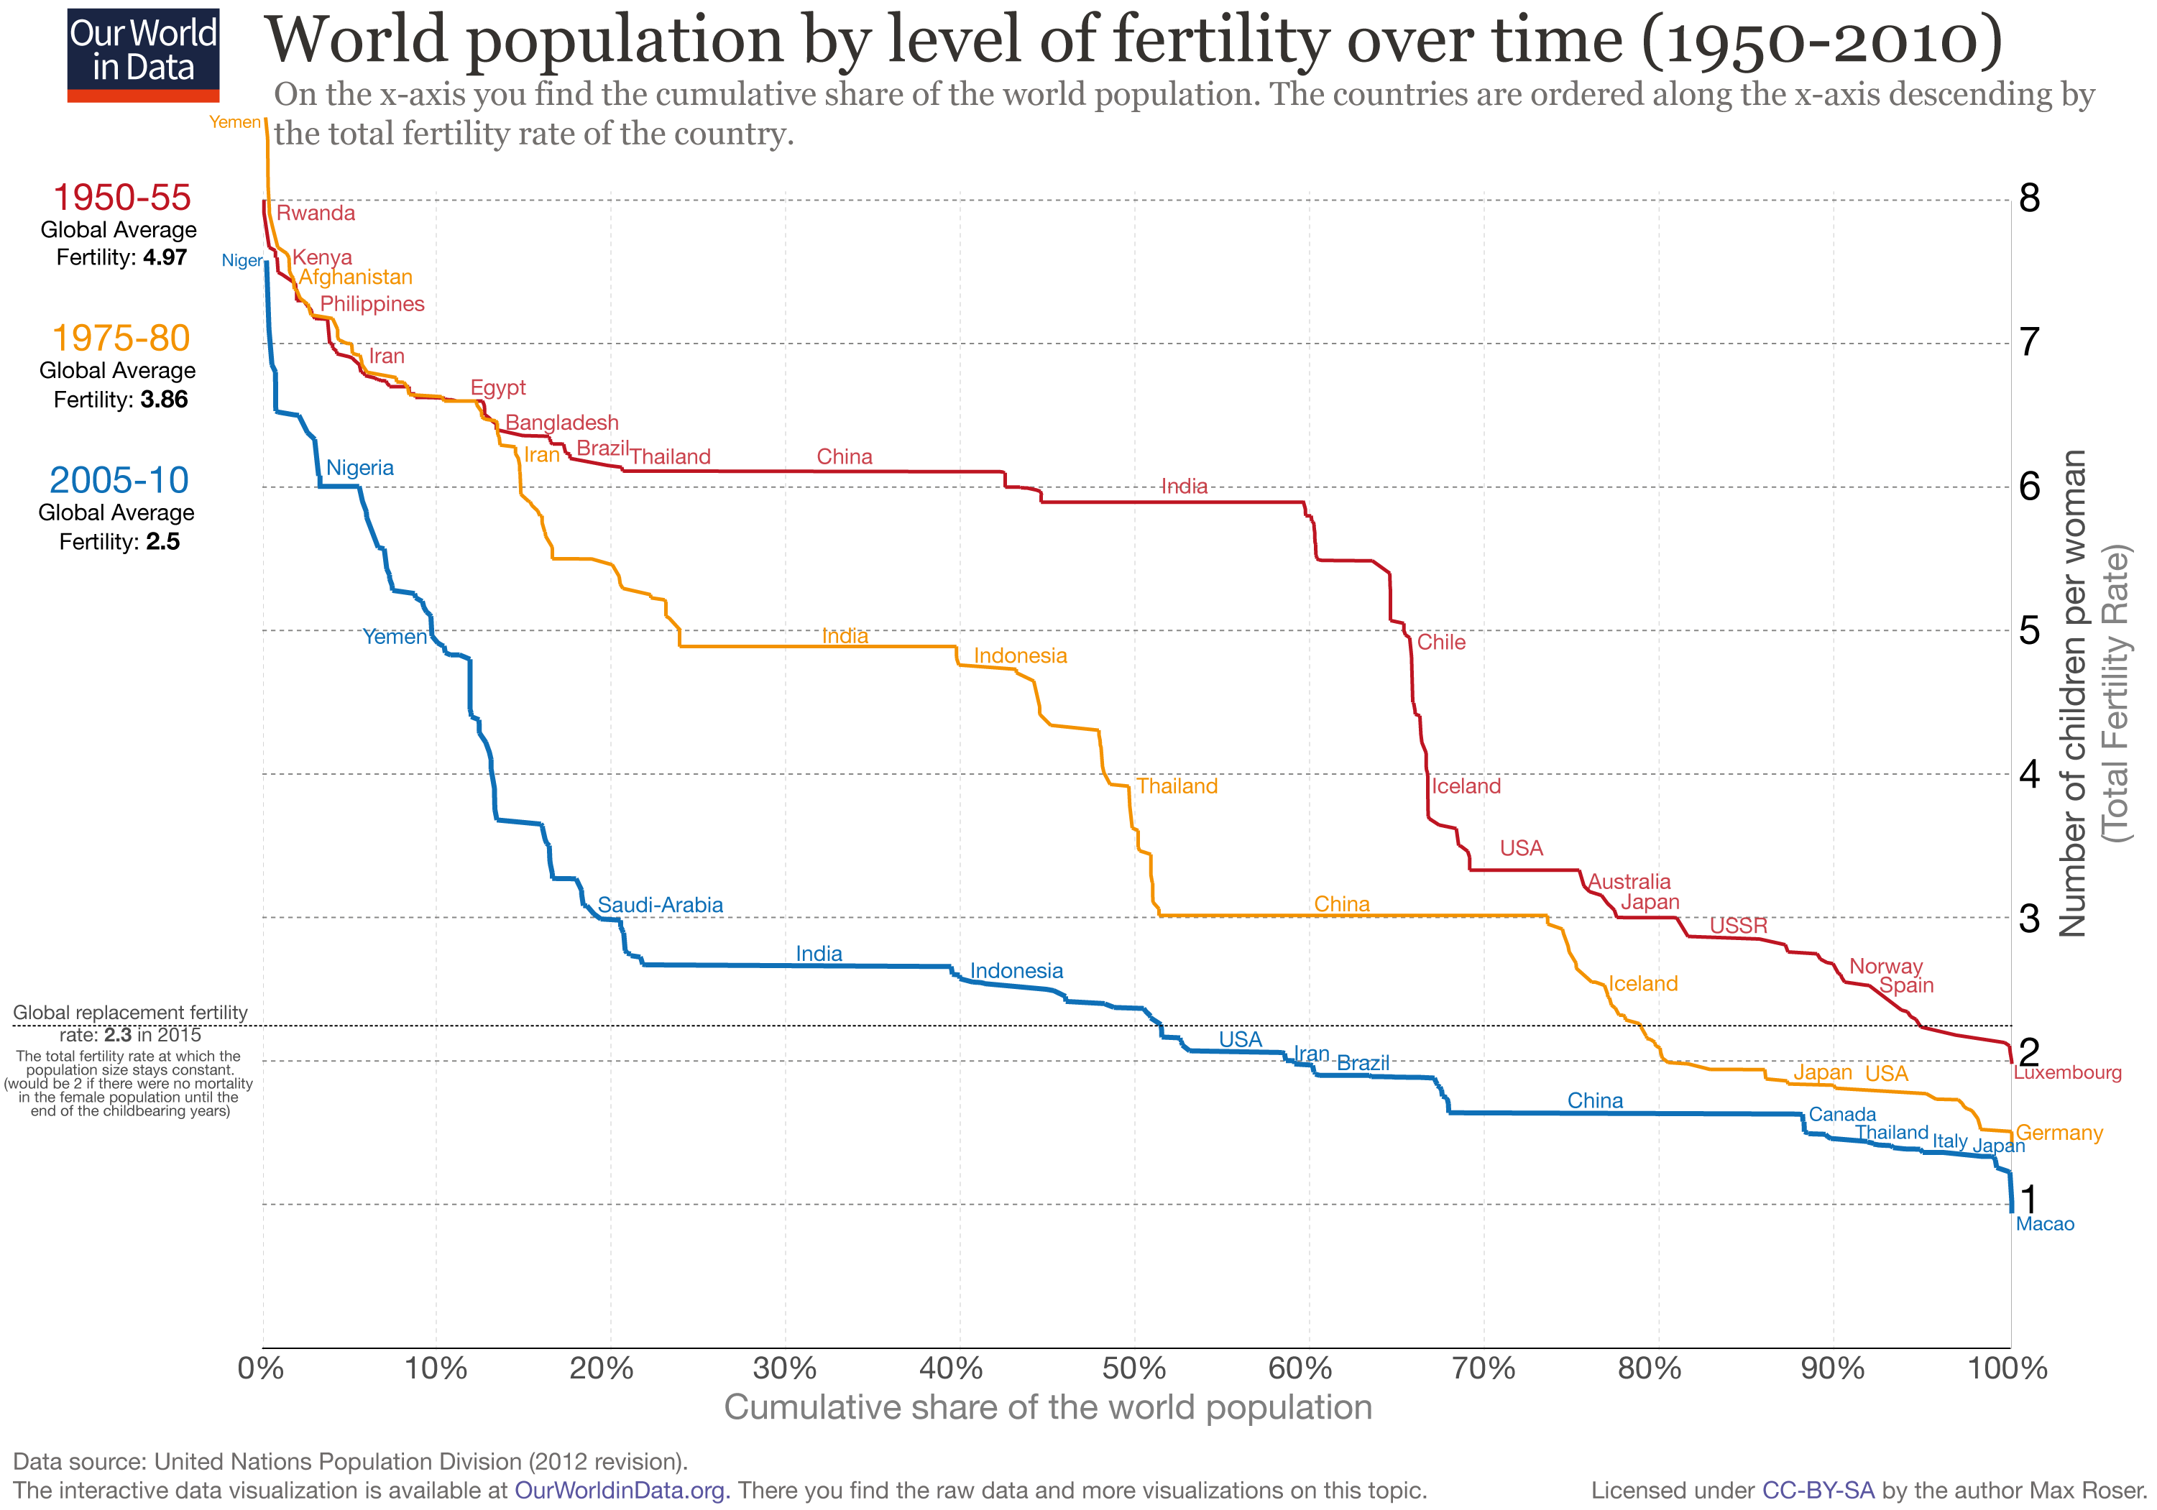
… and counting?

Slide 34
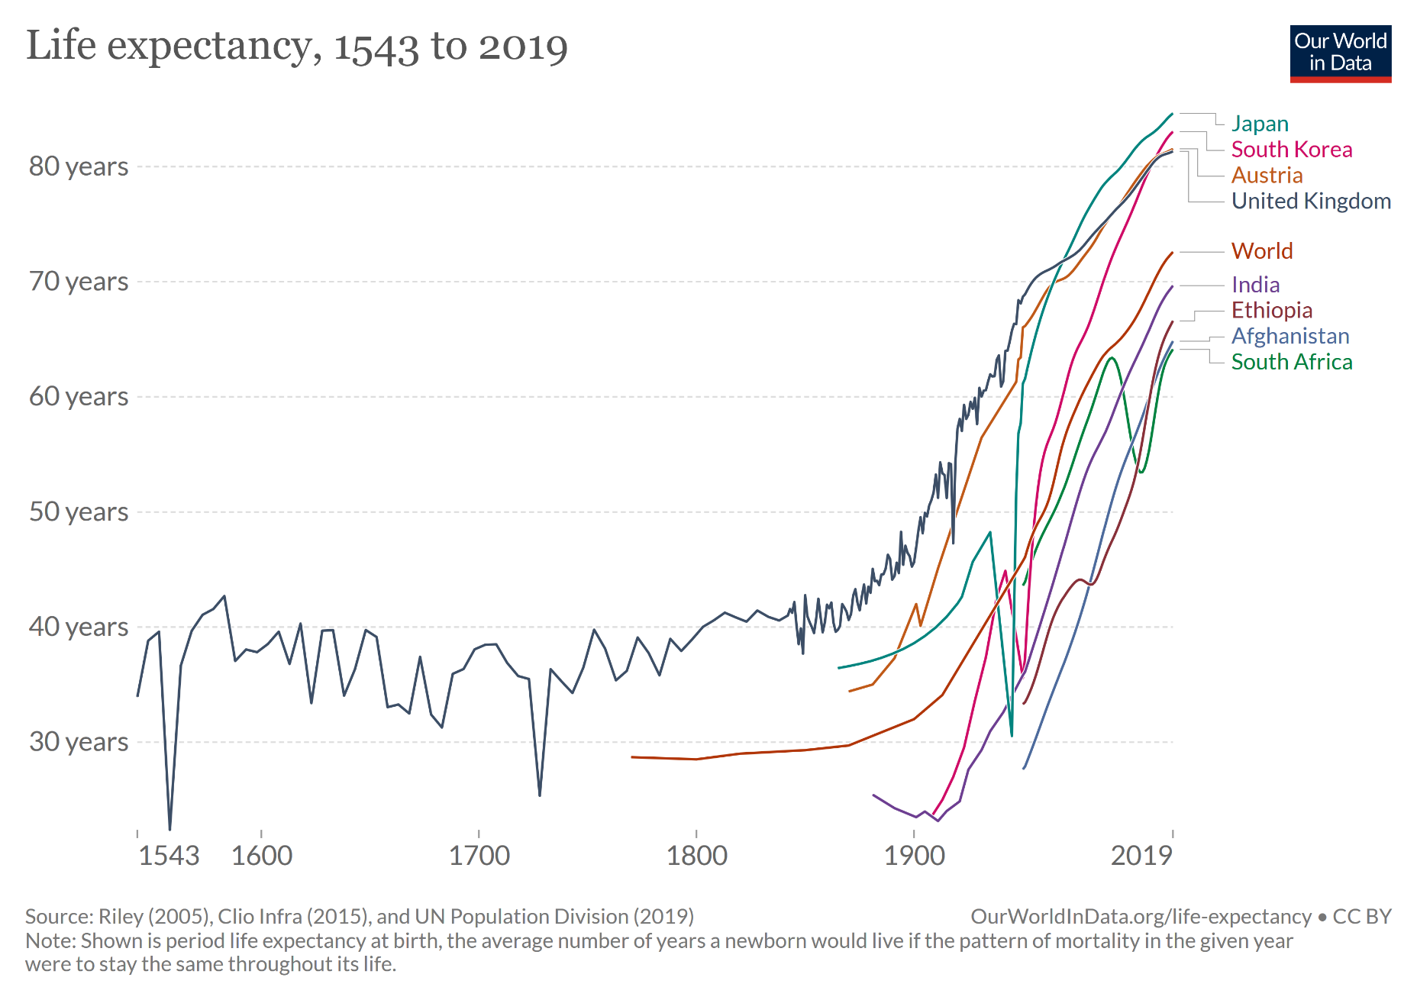
We are getting older

Slide 35

And where are we?

Slide 36
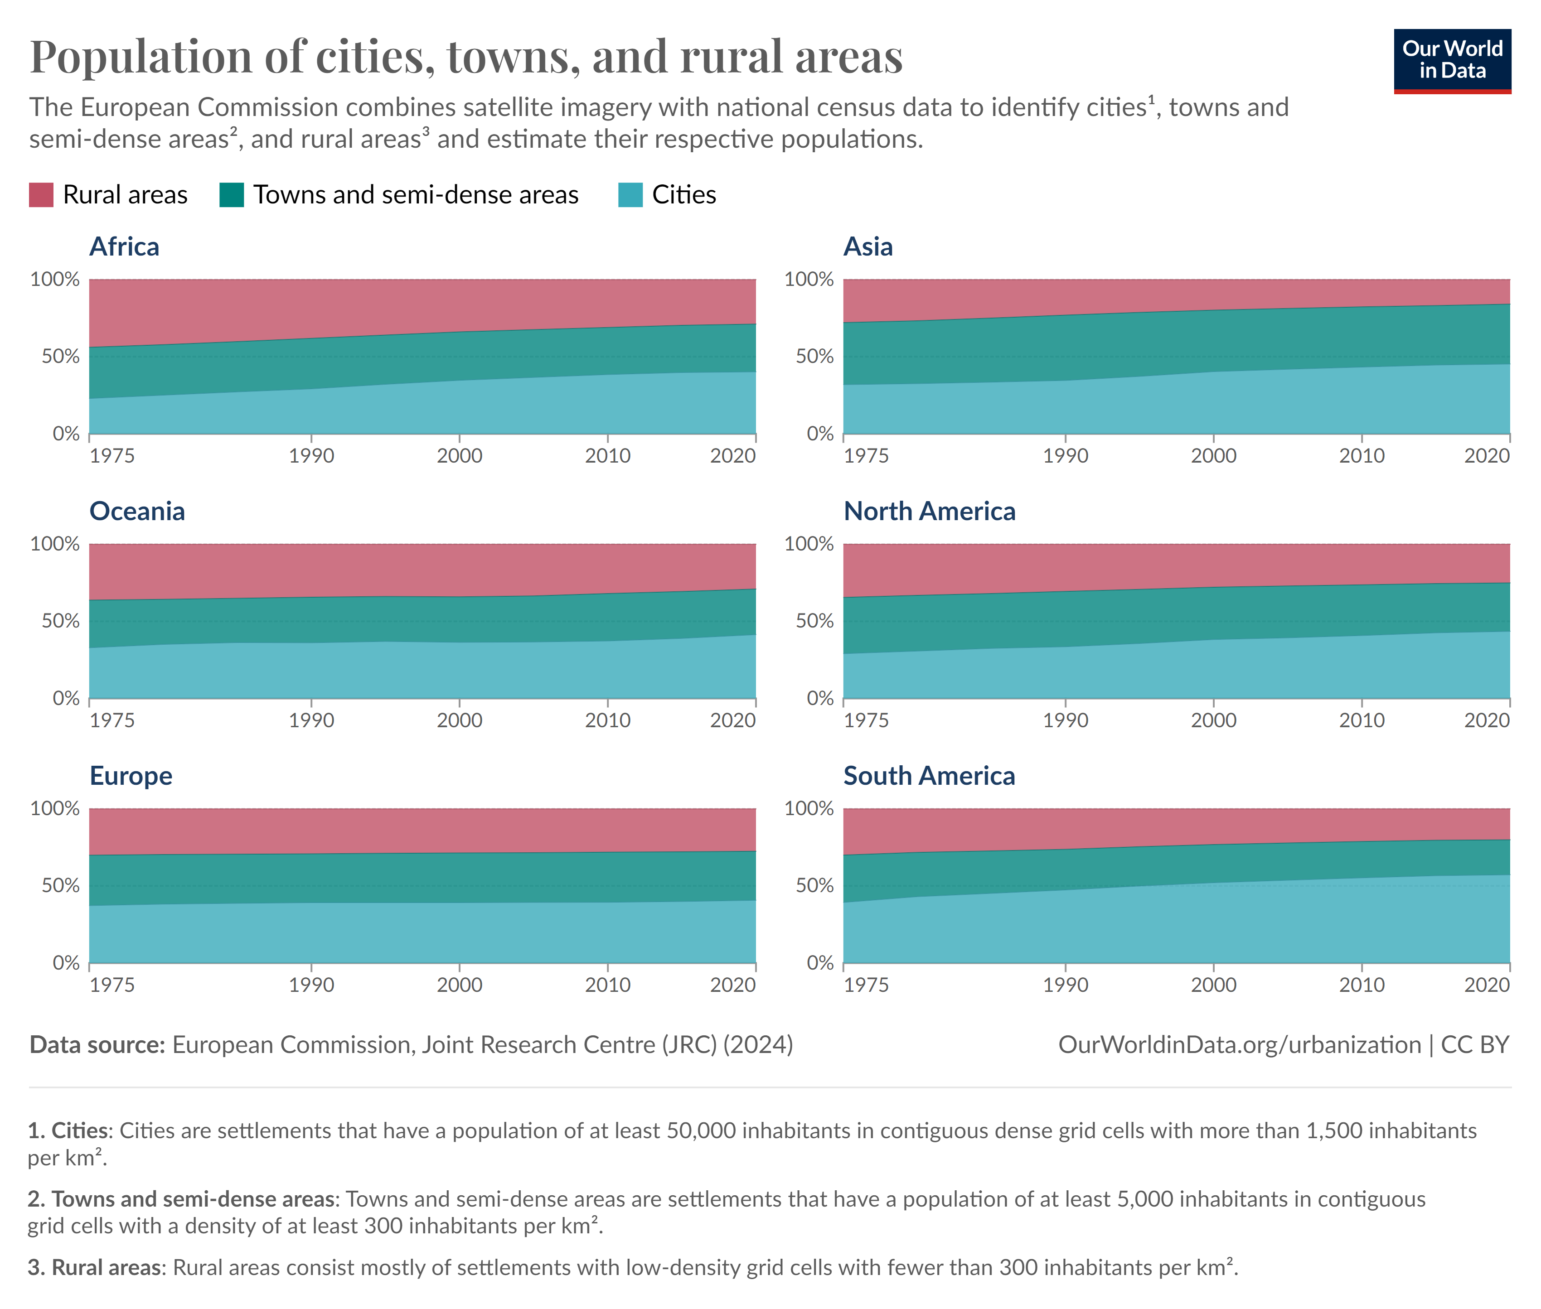
And where are we?

Slide 37
Urban resource hunger
Urban areas:
Urban population will rise: 55% in 2025 to 68% in 2050
70% to 75% of total natural resource consumption
From 40 million tonnes in 2010 to 90 billion tonnes in 2050
75% of global primary energy use
Greater exposure to environmental stressors e.g. air pollution, noise etc.
Potential for greater resource efficiency due to higher densities
E.g. district heating, urban mining, mobility etc.

Slide 38
It’s the economy, stupid!

Slide 39
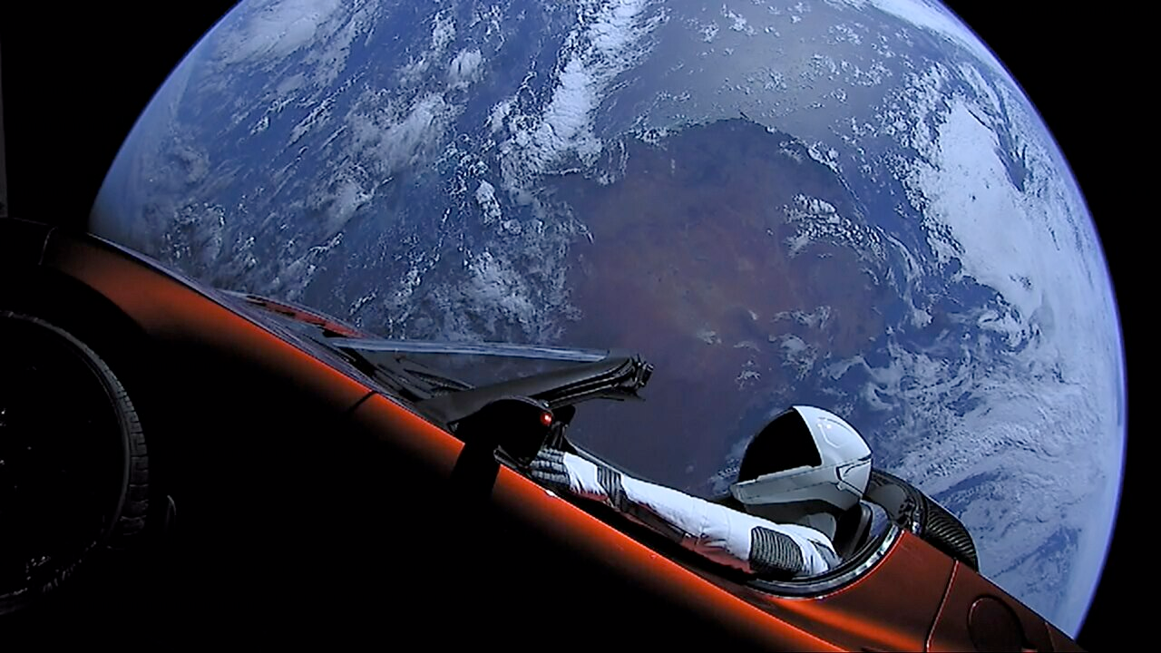
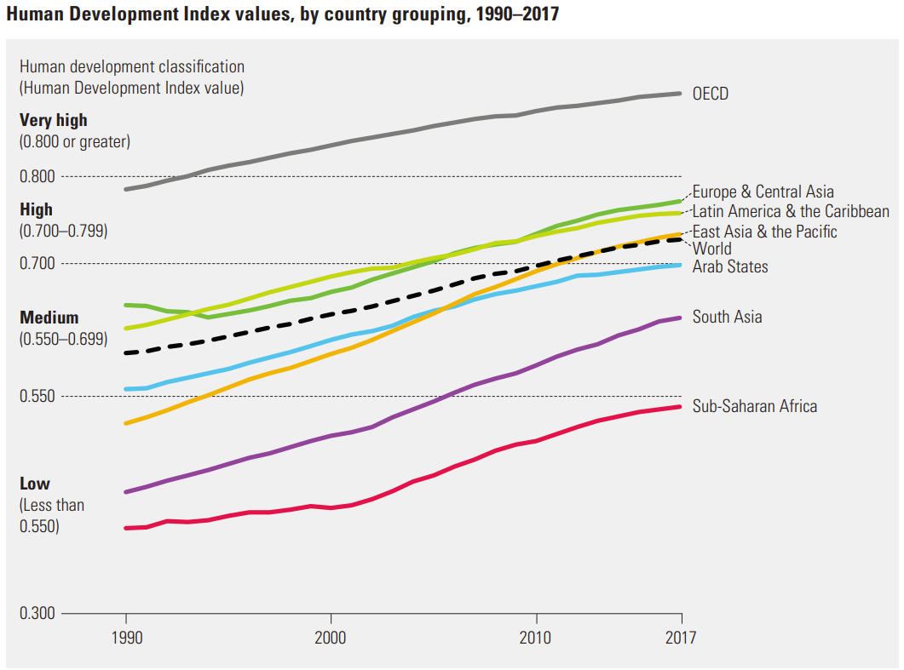
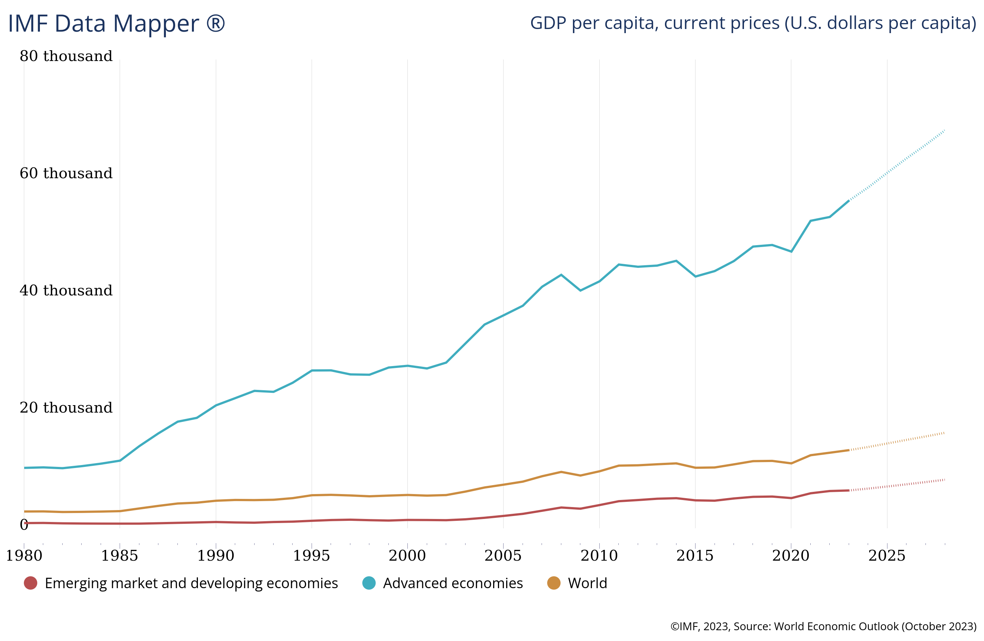
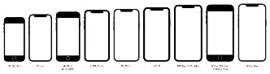
What happened so far …
Human Development Index, by country grouping
GDP per capita, current prices ($)
(IMF, 2023; Tboa, 2020, Wikimedia, CC BY-SA; UN 2018:3)
Notes:
2018: Musk sends his old Tesla to space
HDI:
Long & healthy life: life expectancy at brith
Years of eduction
Decent st&ard of lifing: GNI pc

Slide 40
GD … what?
Gross Domestic Product (GDP): measures the total value of all goods & services produced within a country's borders over a specific period
Components of GDP:
Consumption: Spending by households on goods & services
Investment: Business expenditures on capital, plus residential construction & inventory changes
Government Spending: Expenditures by the government on goods & services
Net Exports: Exports minus imports (EX - IM)

Slide 41
HD … what?
Human Development Index (HDI): composite index measuring average achievement in three basic aspects of human development: health, education, & standard of living
Components of HDI:
Life Expectancy: health & longevity of a population, using life expectancy at birth as an indicator
Education: mean years of schooling for adults with expected years of schooling for children
Income Level: Gross National Income (GNI) per capita (adjusted for purchasing power) to gauge the standard of living
HDI Scale: 0 to 1
Notes:
GNI: focus on income generated by nationals globally
👉 economic well-being of citzens by income from international activities
GDP: focus on national production (regardless who owns facilties)

Slide 42
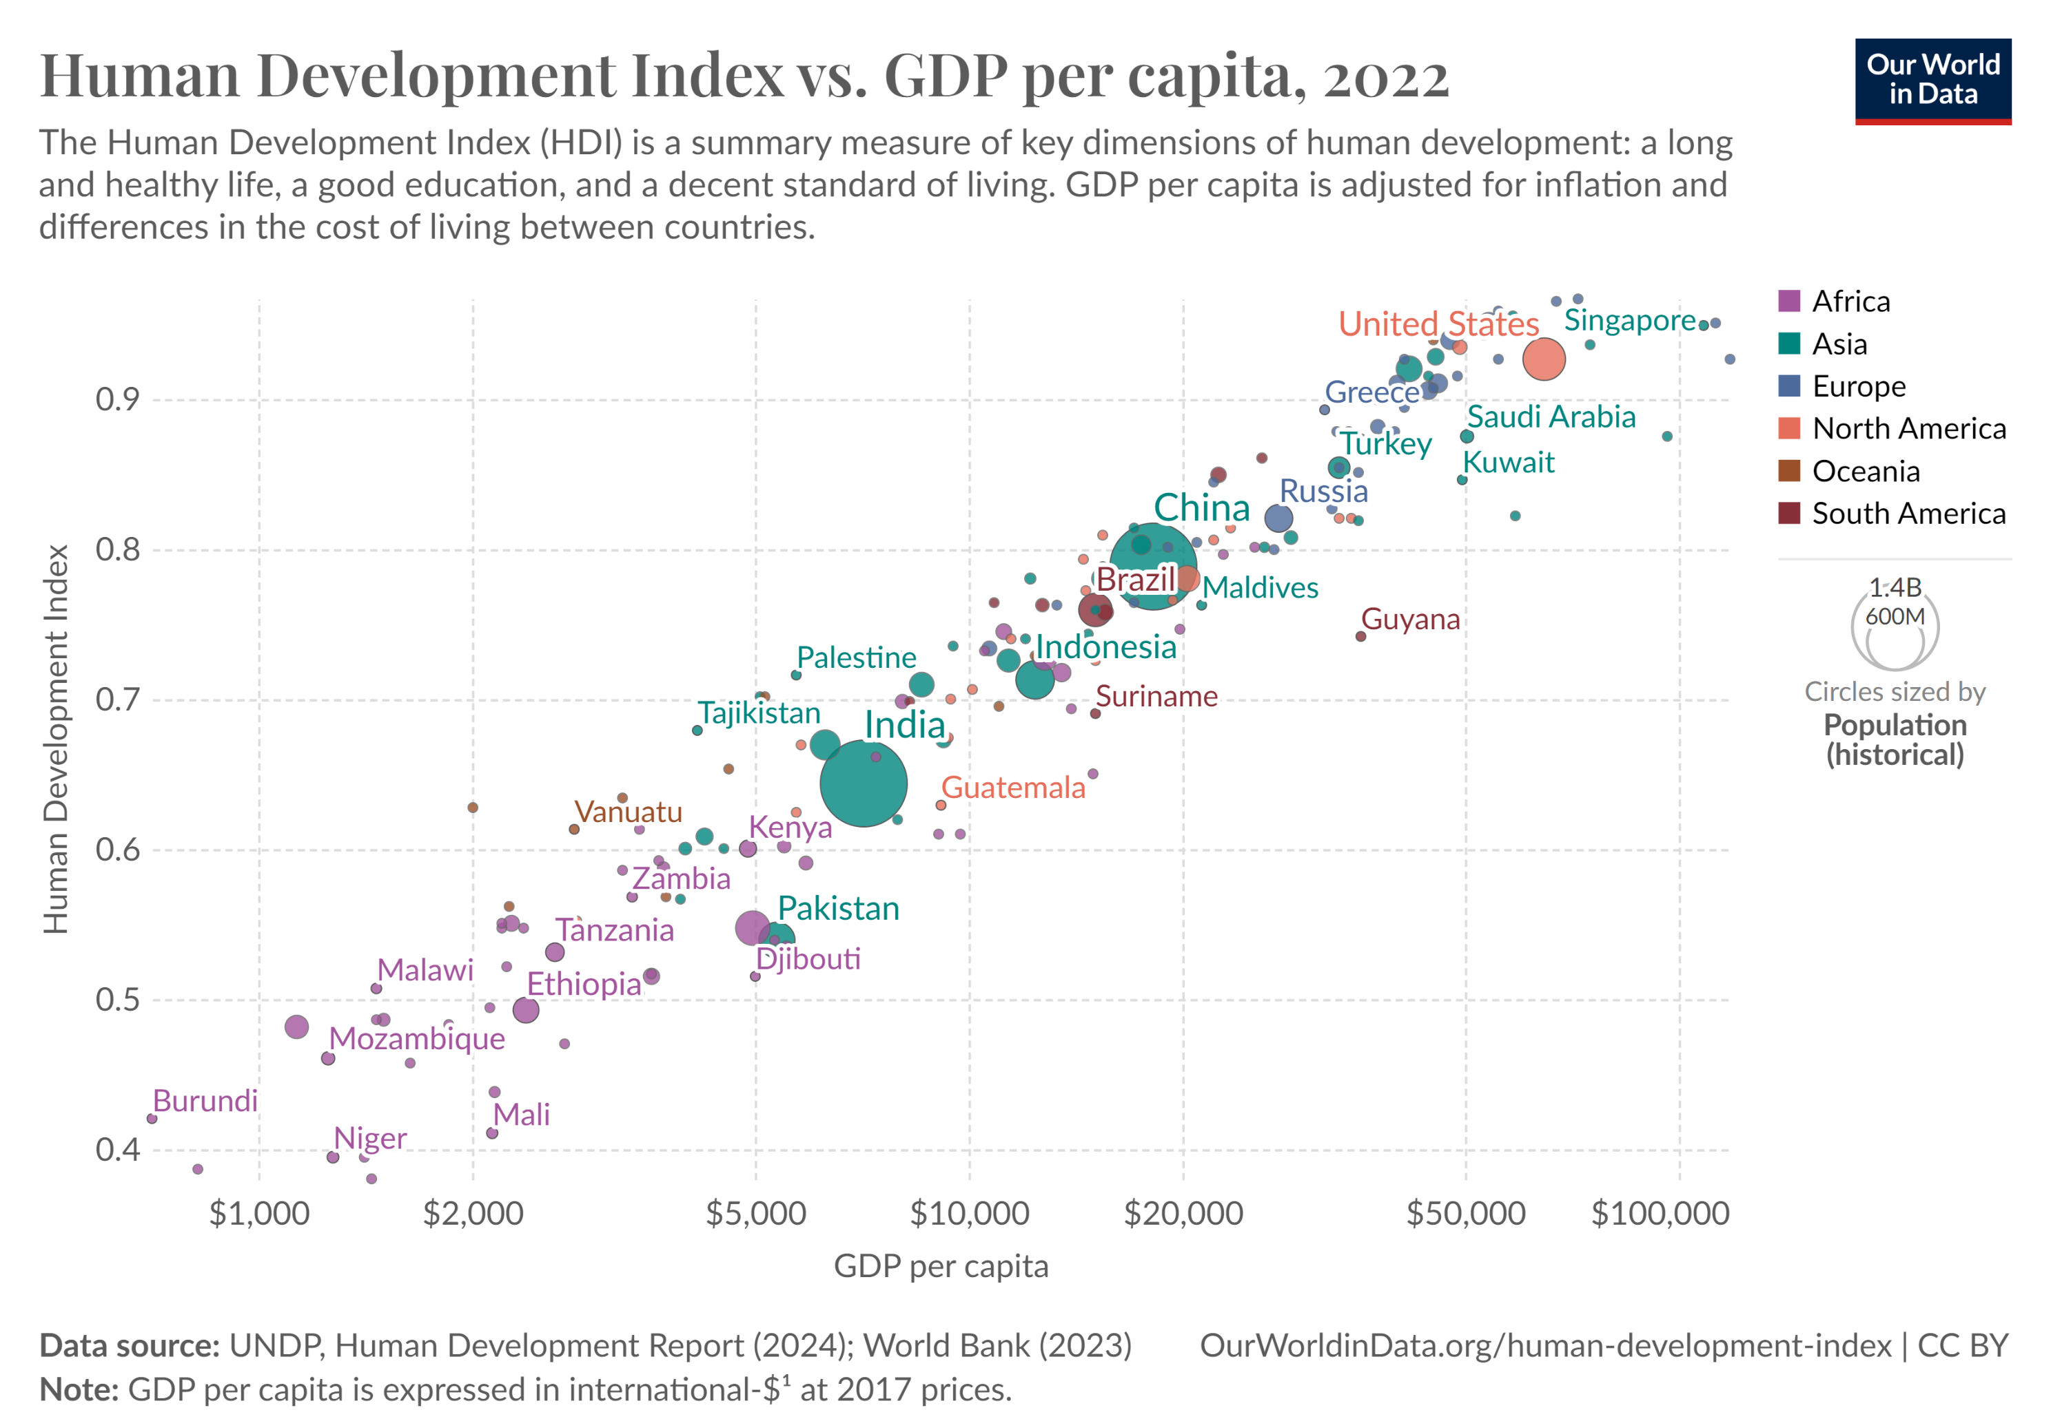
Combined:

Slide 43
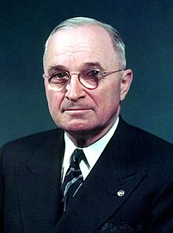
A new area …
“More than half the people of the world are living in conditions approaching misery. Their food is inadequate. They are victims of disease. Their economic life is primitive and stagnant. Their poverty is a handicap and a threat both to them and to more prosperous areas. […] The United States is pre-eminent among nations in the development of industrial and scientific techniques. The material resources which we can afford to use for assistance of other peoples are limited. But our imponderable resources in technical knowledge are constantly growing and are inexhaustible.” (Harry Truman, 1949)

Slide 44
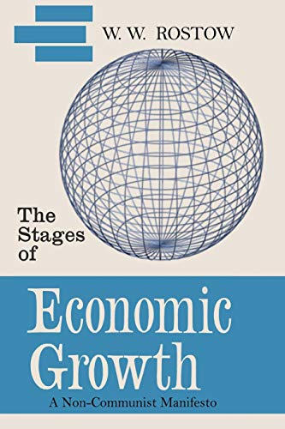
Rostow’s (1960) Stages of Economic Growth
Economic Development = linear Process: Countries pass through distinct stages in a linear progression toward economic maturity & high mass consumption
Industrialization as a key driver: Growth & economic transformation are fueled by industrialization & investment in technology & infrastructure
Investment & Innovation: Economic take-off requires significant investment in technology, education & infrastructure to support productivity & innovation
Role of Consumption in Mature Economies: Advanced stages are marked by high levels of consumer spending, shift towards service industries, reflecting improved living standards
Model for Economic Planning: Provides a roadmap for countries looking to advance economically, highlighting the need for strategic investment & policy interventions

Slide 45
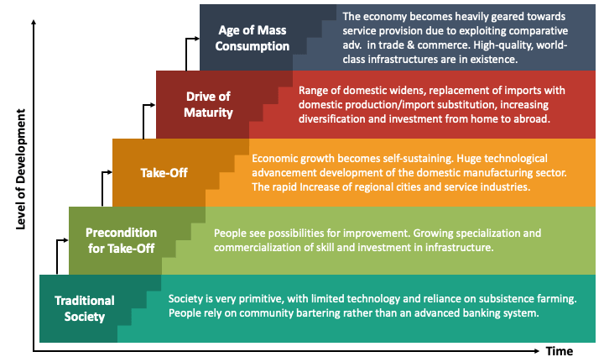
Rostow's Stages of Economic Growth
Notes:
The Five Stages:
Traditional Society:
Characterized by subsistence agriculture & limited technology.
Social structures are rigid, with little emphasis on economic growth.
Pre-Conditions for Take-Off:
Emergence of new industries & infrastructure development (e.g., transportation, communication).
Increase in investment, particularly in technology & education.
Shift from agriculture to manufacturing begins.
Take-Off:
Rapid industrialization, with significant technological advancements.
Growth in productivity & urbanization.
Emergence of key industries that drive economic growth (e.g., textiles, railways).
Drive to Maturity:
Diversification of the economy, with more complex industries (e.g., heavy industry, chemicals).
Investment in social infrastructure (education, healthcare) & technological innovation.
Increase in national income & a higher st&ard of living.
Age of High Mass Consumption:
Shift towards a consumer-oriented economy, with focus on services & high-quality goods.
Increased income leads to widespread access to goods & services.
Welfare state & social programs become prominent.

Slide 46
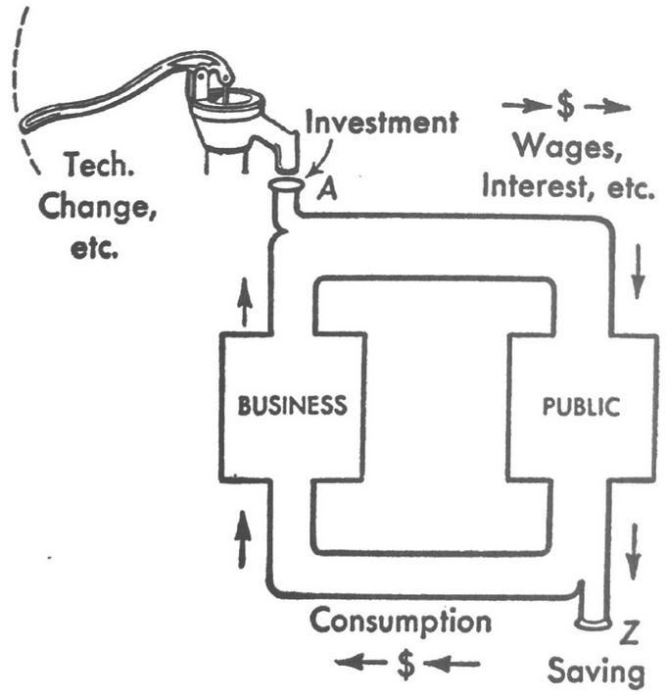
Rostow’s predecessors: Samuelson’s (1948) iconic “Circular Flow” of income

Slide 47
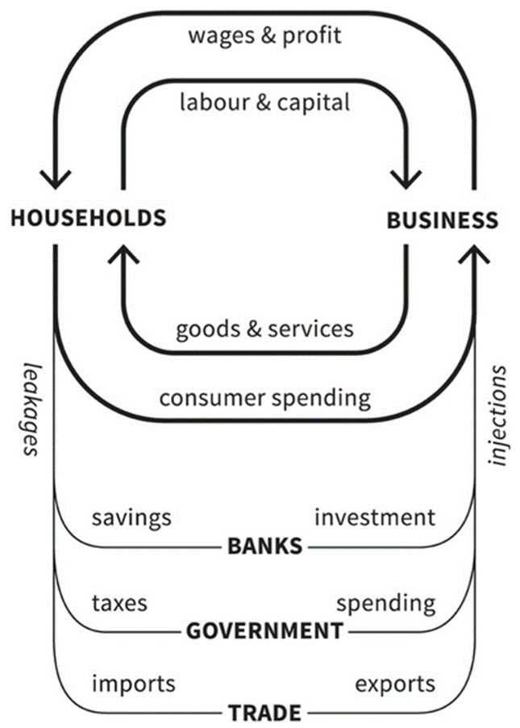
Digression: Samuelson (1948) iconic “Circular Flow” reloaded

Slide 48
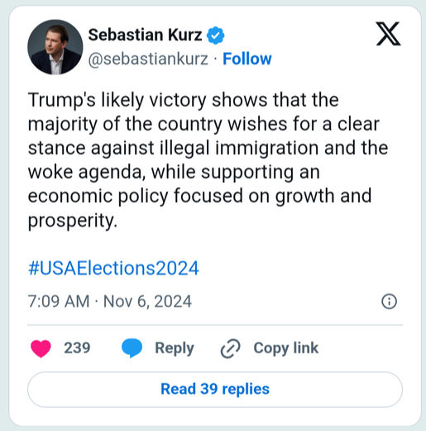
Rostow's Stages of Economic Growth today
Notes:
The Five Stages:
Traditional Society:
Characterized by subsistence agriculture & limited technology.
Social structures are rigid, with little emphasis on economic growth.
Pre-Conditions for Take-Off:
Emergence of new industries & infrastructure development (e.g., transportation, communication).
Increase in investment, particularly in technology & education.
Shift from agriculture to manufacturing begins.
Take-Off:
Rapid industrialization, with significant technological advancements.
Growth in productivity & urbanization.
Emergence of key industries that drive economic growth (e.g., textiles, railways).
Drive to Maturity:
Diversification of the economy, with more complex industries (e.g., heavy industry, chemicals).
Investment in social infrastructure (education, healthcare) & technological innovation.
Increase in national income & a higher st&ard of living.
Age of High Mass Consumption:
Shift towards a consumer-oriented economy, with focus on services & high-quality goods.
Increased income leads to widespread access to goods & services.
Welfare state & social programs become prominent.

Slide 49
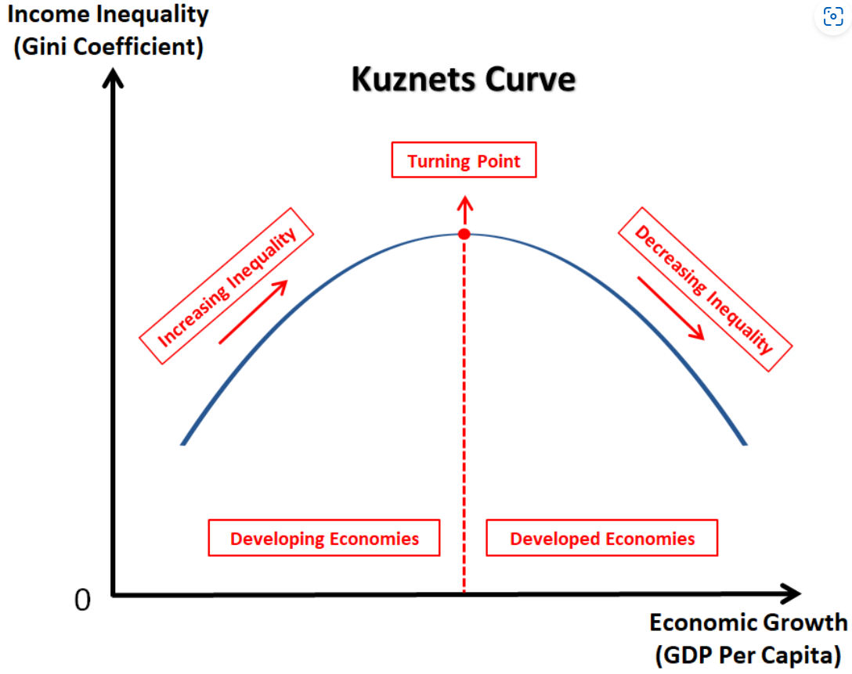
Kuznets (1955) prediction:
Focus on growth & income equality:
Early stage:
Agriculture 👉 industry
inequality increases
Middle stage: highest inequality
Later stage:
Redistribution mechanisms 👉 inequality reduced
“higher” development 👉 reduction of inequalities

Slide 50
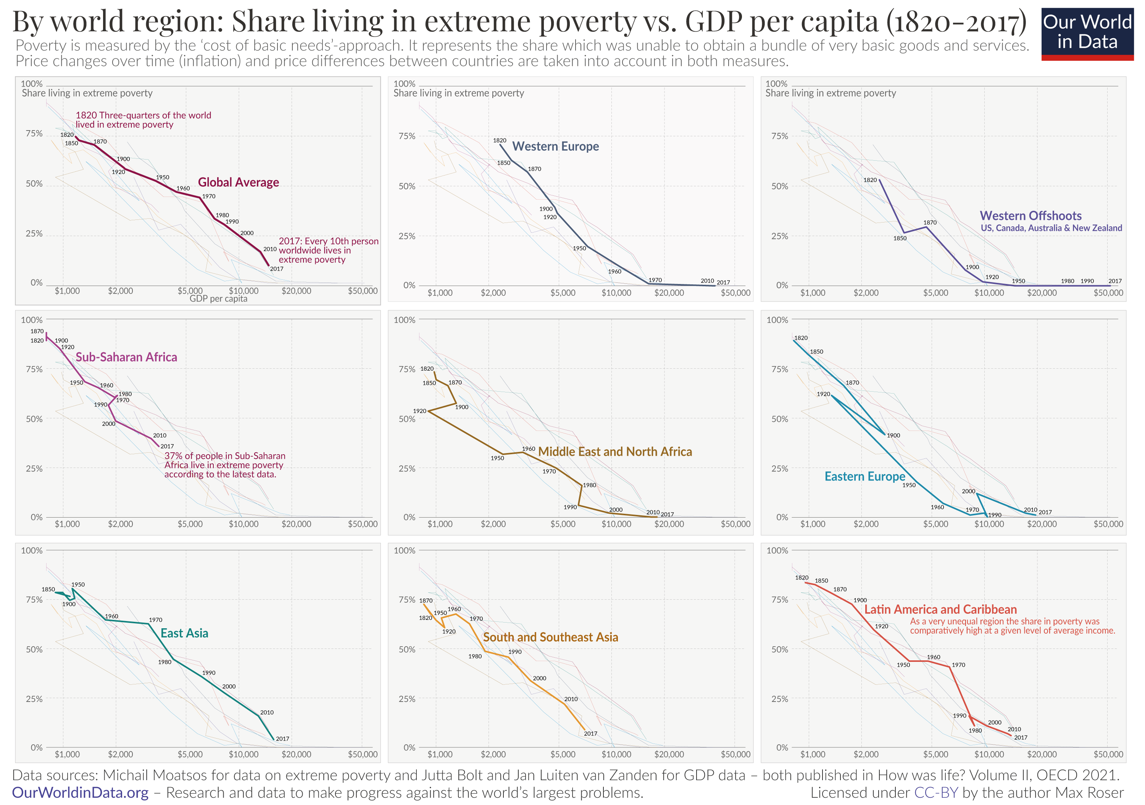
Kuznet revisited

Slide 51
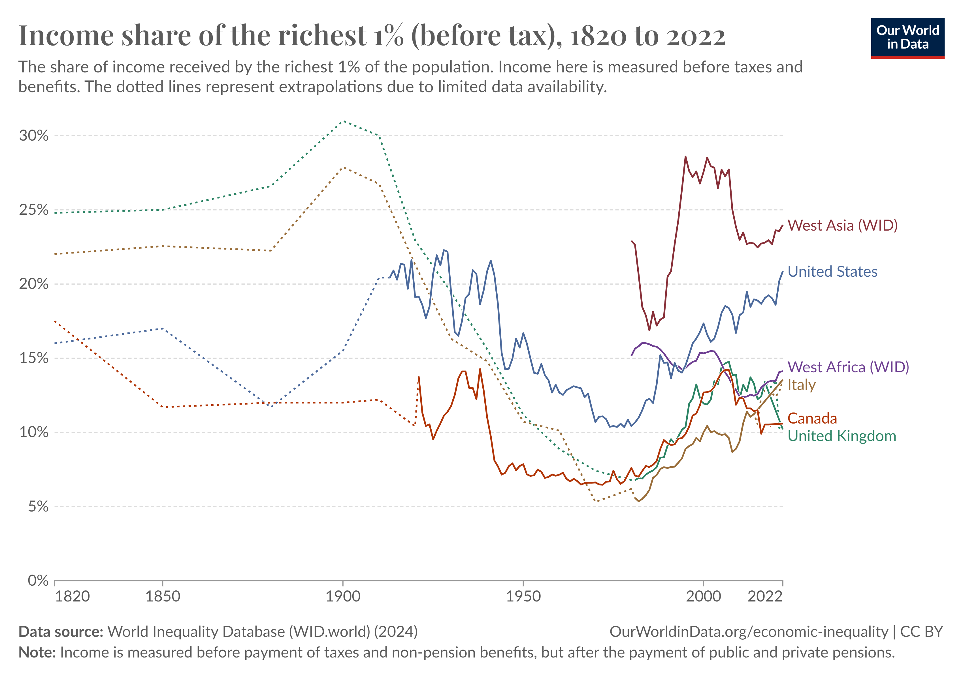
Kuznet revisited

Slide 52
And the ecological impact?

Slide 53
Human causes of Global Change

Slide 54
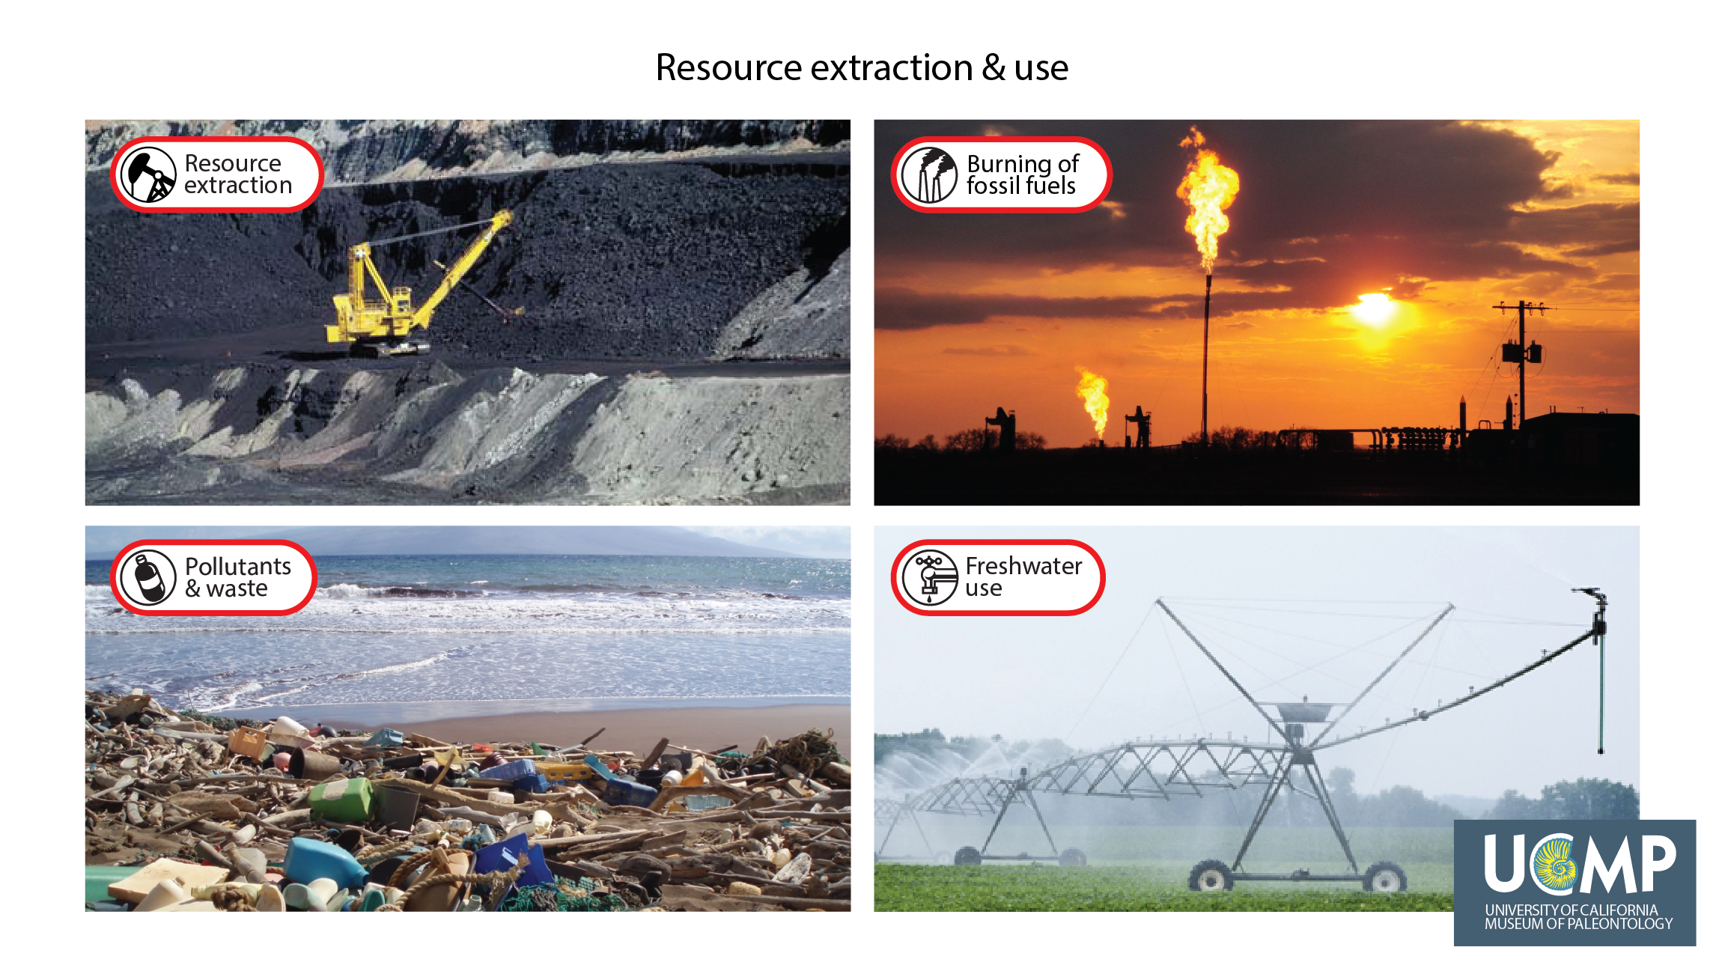
Human activities relevant for Global Change

Slide 55
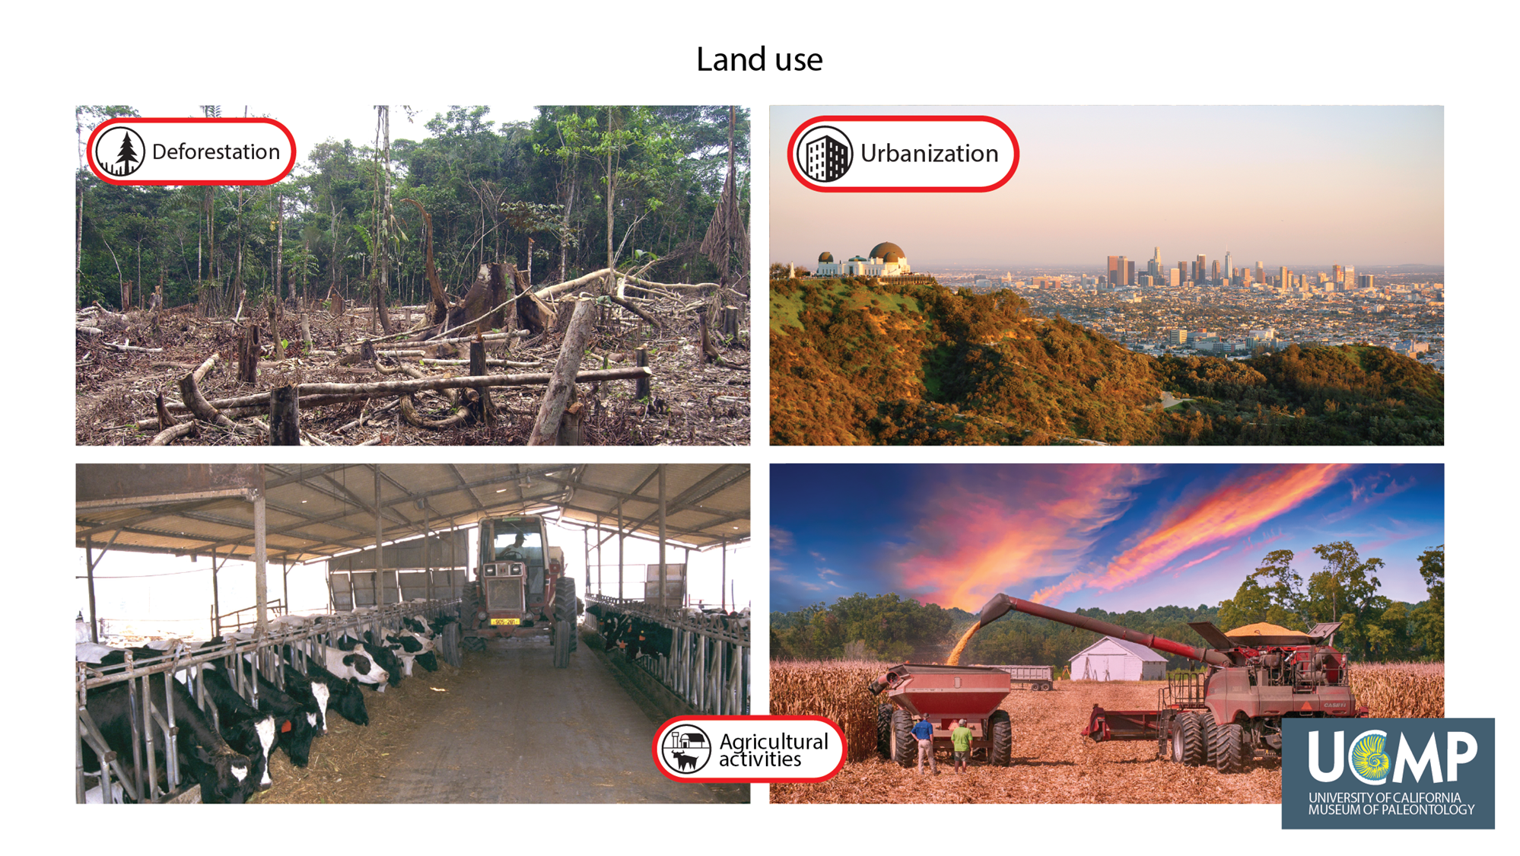
Human activities relevant for Global Change

Slide 56
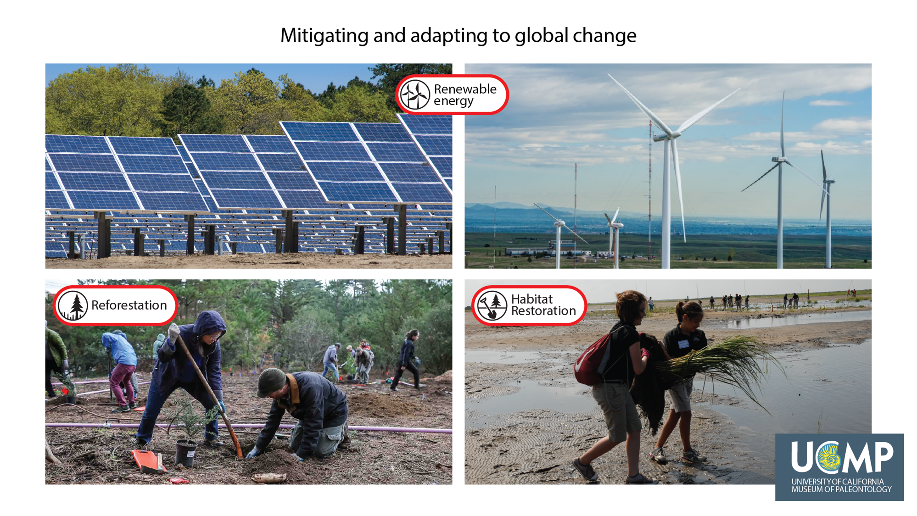
Human activities relevant for Global Change

Slide 57
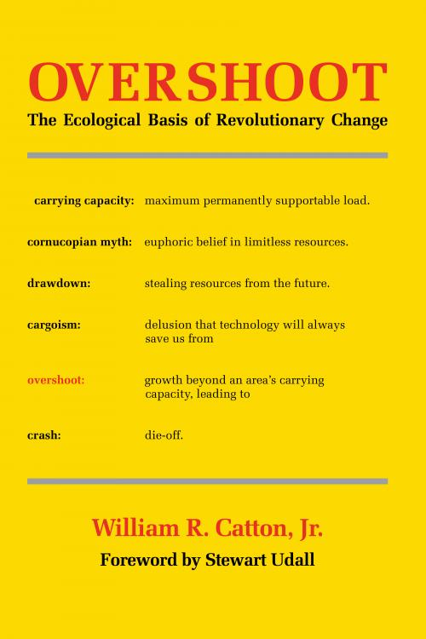


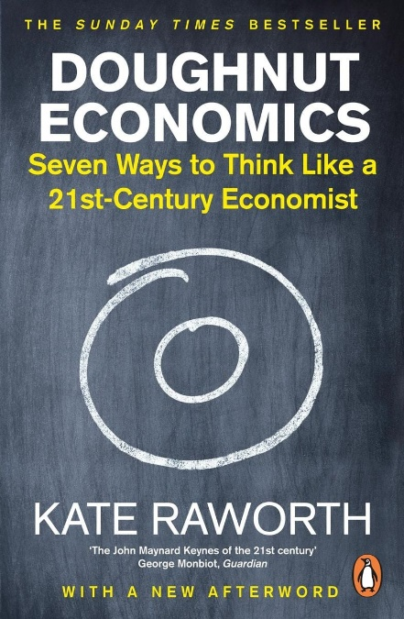
Reviewing our socio-ecological performance
Notes:
1980: Catton – AUT 07.04 (Rückgang von Dez in 1961)
1997: Schmidt Bleek
1996: Weizäcker: Faktor 4
1996: Wackernackel
2017: donought economics Kate Raworth
Linear Economy: Take – make – Waste Approach

Slide 58
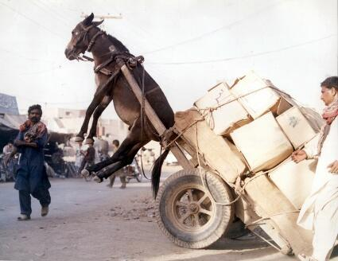
💡Ecological carrying capacity (aka: There are limits)

Slide 59
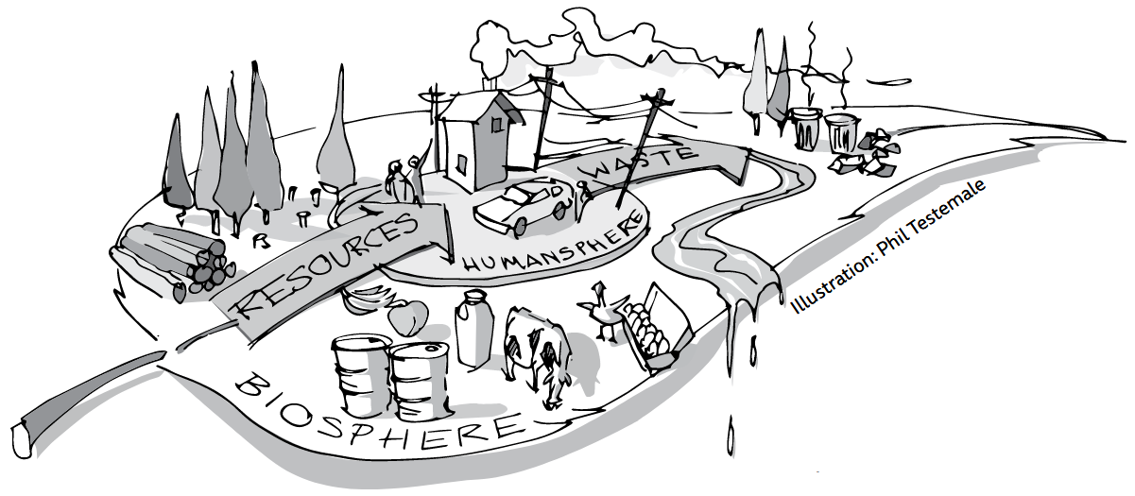
Digression: Ecological Footprint?
Built-up l&
Fish Footprint
Carbon Footprint
Forest product Footprint
Grazing Footprint
Cropland Footprint

Slide 60
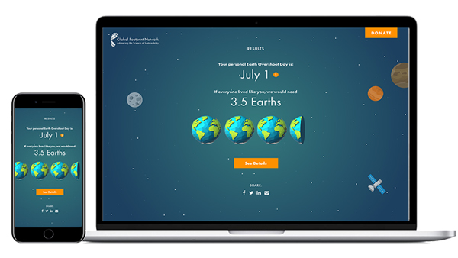
How big is your Ecological Footprint?
https://www.footprintcalculator.org/

Slide 61

Our national footprints

Slide 62

Our national Overshoot Days

Slide 63

Looking back

Slide 64

Reviewing our performance so far
(Azote for Stockholm Resilience Centre, based on analysis in Richardson et al 2023; CC BY-NC-ND)

Slide 65

Planetary Boundaries: A closer look
Climate Change: Excess greenhouse gases trap heat, raising global temperatures and disrupting climate stability (boundary transgressed).
Novel Entities: Uncontrolled release of synthetic chemicals and substances exceeds safe levels, posing unknown risks to ecosystems (boundary transgressed).
Stratospheric Ozone Depletion: Ozone layer thinning from human-made chemicals increases UV exposure but is recovering within safe levels.
Atmospheric Aerosol Loading: Airborne particles from human activities impact climate and weather, currently within safe levels.
Ocean Acidification: Rising CO₂ levels reduce ocean pH, threatening marine life, yet remain within safe bounds but close to the limit.
Biogeochemical Flows: Human disruption of nitrogen and phosphorus cycles overloads ecosystems, exceeding safe boundaries.
Freshwater Change: Human alterations in freshwater systems reduce biodiversity and ecosystem functions, surpassing safe limits.
Land System Change: Deforestation and land conversion degrade ecosystems and carbon storage, exceeding safe levels.
Biosphere Integrity: Declining biodiversity weakens the planet’s self-regulation, with genetic and functional diversity below safe thresholds.

Slide 66

Conclusion: Our understanding of development is too resource intense

Slide 67
And the consequences of crossing planetary boundaries?

Slide 68

And the consequences of crossing planetary boundaries?

Slide 69
An example …

Slide 70


Me & my smartphone …

Slide 71

Me & my smartphone …
Notes:
Kolwezi, Democratic Republic of Congo
Chengdu, People Repuclic of China
Krems, Austria
Agbogbloshie near center Accra, Ghana

Slide 72

What’s inside:

Slide 73
What’s inside:
2. Rare Earth Elements
Neodymium: Used in magnets for speakers & microphones.
Indium: Coated on touch screens to enhance conductivity.
Gallium: Employed in semiconductors.
3. Plastics
Polycarbonate: Frequently used for phone casings due to its flexibility & shock resistance.
Acrylics & other polymers: Used for various internal components & external casings.
4. Glass
Gorilla Glass: A type of strengthened glass used for screens, resistant to scratches & impacts.
Ceramic glass: Sometimes used for both the front & back of high-end smartphones.
5. Additional Components
Silicon: The primary material for microprocessors, derived from quartz.
Graphite: Used in battery electrodes as a conductive material.
Mercury: Found in some display components but increasingly regulated due to environmental concerns.
1. Metals
Aluminium: Commonly used for the casing due to its lightweight & durability. It also aids in heat dissipation.
Copper: Essential for electrical wiring & components, facilitating efficient current flow.
Gold: Utilized in circuit boards for its excellent conductivity & resistance to corrosion.
Silver: Another conductive material used in various electronic components.
Tantalum: Used in capacitors for filtering & frequency tuning; sourced mainly from Central Africa & Brazil.
Lithium: A critical component of lithium-ion batteries, sourced from countries like Australia, Chile, & Argentina.
Cobalt: Often used in battery production; major sources include the Democratic Republic of Congo.
Notes:
75% of the elements from the periodic table

Slide 74


… & then?

Slide 75

… & then?

Slide 76

… & then?
Notes:
80% end up in global south 83% treatment of e-waste is unknown Transboundary movement of discarded EEE: Global e-waste flows monitor 2022 | WMW

Slide 77

… & then?
Notes:
80% end up in global south 83% treatment of e-waste is unknown Transboundary movement of discarded EEE: Global e-waste flows monitor 2022 | WMW

Slide 78


A conclusion: Dominant linear model

Slide 79



A conclusion: Dominant linear model

Slide 80
Looking back: Rostow's Stages of Economic Growth
Notes:
The Five Stages:
Traditional Society:
Characterized by subsistence agriculture & limited technology.
Social structures are rigid, with little emphasis on economic growth.
Pre-Conditions for Take-Off:
Emergence of new industries & infrastructure development (e.g., transportation, communication).
Increase in investment, particularly in technology & education.
Shift from agriculture to manufacturing begins.
Take-Off:
Rapid industrialization, with significant technological advancements.
Growth in productivity & urbanization.
Emergence of key industries that drive economic growth (e.g., textiles, railways).
Drive to Maturity:
Diversification of the economy, with more complex industries (e.g., heavy industry, chemicals).
Investment in social infrastructure (education, healthcare) & technological innovation.
Increase in national income & a higher st&ard of living.
Age of High Mass Consumption:
Shift towards a consumer-oriented economy, with focus on services & high-quality goods.
Increased income leads to widespread access to goods & services.
Welfare state & social programs become prominent.

Slide 81

A conclusion: Dominant linear model

Slide 82
& now: Circular Economy?

Slide 83
💡Ecological carrying capacity (aka: there are limits)

Slide 84
Reviewing our socio-ecological performance from an earth-systems perspective
Notes:
1980: Catton – AUT 07.04 (Rückgang von Dez in 1961)
1997: Schmidt Bleek
1996: Weizäcker: Faktor 4
1996: Wackernackel
2017: donought economics Kate Raworth
Linear Economy: Take – make – Waste Approach

Slide 85
Earth-Systems Perspective?
Holistic approach: Earth = interconnected system
atmosphere, hydrosphere, biosphere, lithosphere, anthroposphere
Dynamic interactions:
processes, feedback loops, and thresholds influencing system stability
positive (amplifying) and negative (stabilising) feedbacks
Planetary boundaries: safe operating limits for Earth’s systems
climate, biodiversity, etc.
Temporal and spatial scales
processes from local to global and short to geological timescales
Interdisciplinarity: insights from natural and social sciences to understand complex interactions
Human Role: humans = dominant geological force 👉 Anthropocene
Focus on resilience: system capacity to absorb disturbances and adapt to change

Slide 86

Understanding society as hybrid system (e.g. Fischer-Kowalski and Weisz 1999)

Slide 87



Understanding society as hybrid system (e.g. Fischer-Kowalski and Weisz 1999)

Slide 88
The Vienna School of Socio Ecology (~ 1990)
Interdisciplinary Approach:
natural sciences, social sciences, and humanities 👉 study human-environment interactions
Socio-Metabolic Perspective:
how societies consume energy and materials to sustain themselves 👉 "social metabolism"
Focus on the impacts of material and energy flows on ecosystems
Long-Term Sustainability:
historical trends in resource use and their implications for future sustainability
Advocates for systemic change to reduce ecological footprints and transition to sustainable practices
Notes:
Societies are seen as systems that rely on inputs (resources) and produce outputs (waste).
The school emphasizes reducing these flows to sustainable levels.

Slide 89
Key concepts in a socio-ecological perspective:
Socio-Ecological Transitions:
How societies have transitioned through phases like industrialisation
what is required for a shift to sustainability
how to achieve a "low-carbon" or "circular" economy
Human-Environment Systems:
social and ecological systems = deeply intertwined and co-evolving
changes in one system inevitably affect the other

Slide 90

@ Metabolism:
(direct) energy
Notes:
DPO: domestic processed outputs - wastes, emissions, dissipatively used materials and deliberate deposition

Slide 91


To sum it up: We’ve come a long way

Slide 92

To sum it up: We’ve come a long way

Slide 93
Metabolic vs. isolated perspective on economy
(direct) energy
Notes:
DPO: domestic processed outputs - wastes, emissions, dissipatively used materials and deliberate deposition
Rechts: Self-contained markets

Slide 94

A fundamental shift in perspective:

Slide 95

A fundamental shift in perspective:

Slide 96





From linear to circular strategies:

Slide 97

From linear to circular strategies:

Slide 98
From linear to circular strategies:

Slide 99
BREAK

Slide 100
Defining circualar economy

Slide 101
How to define “Circular Economy”?
🤔

Slide 102
Walter Stahel’s (2016) Plea for a “Circular Economy”

Slide 103

A “definitional quagmire” (Corvellec et al., 2022:2):

Slide 104

Despite the “definitional quagmire”:
👉 Umbrella concept:
“an economic system that seeks to eliminate waste and pollution, circulate products and materials at their highest value, and regenerate nature.“ (EllenMacArthur Foundation, 2023)
“A model of production and consumption that emphasizes sharing, leasing, reusing, repairing, refurbishing, and recycling materials and products for as long as possible. “(EU Commission, 2022)
“a system enabling social progress, preservation of natural capital, and economic development. Its goal is to decouple economic growth from resource depletion by fostering innovative products, services, and business models that optimize resource use throughout the product lifecycle“ (United Nations, n.y.)
Notes:
Linear: Take – make – waste
80% environmental impact from insufficient design (EC, 2020:3)
Walter Stahel: 1982 „closed loop economy“
2013: Ellen MacArthur Foundation Vol. 1
3R: 2008 Circular Economy Promotion Law of the People’s Republic of China

Slide 105
Despite the “definitional quagmire”:
Umbrella concept: “economic system that replaces the ‘end-of-life’ concept with reducing, alternatively reusing, recycling & recovering materials in production /distribution & consumption processes.” (Kirchherr, 2017:224)
Notes:
MacArthur:
Eliminate waste & pollution
Circulate products & materials (at their highest value)
Regenerate Nature

Slide 106



A (common) vision?
Notes:
Principles, pillars, levers

Slide 107
A (common) vision?

Slide 108
1. Design Out Waste and Pollution
Key Idea: Waste and pollution result from design flaws
Goal: Eliminate waste at the source.
Strategies:
Innovative Design: Create products and systems to minimise resource loss
Non-Toxic Materials: Use safe, sustainable inputs
Efficient Processes: Optimise production to reduce emissions and waste
Focus: Prevent waste instead of managing it

Slide 109
2. Keep Products and Materials in Use
Key Idea: Maximise the value of products and materials 👉 keep in use
Goal: Extend product life & reduce waste
Strategies:
Durability: Design products to last longer
Reuse and Repair: Encourage reuse, repair, and refurbishment
Remanufacturing and Recycling: Reintroduce materials into the economy after use
Sharing Models: leasing, sharing, or product-as-a-service
Focus: Shift from “take-make-dispose” to a circular flow of resources

Slide 110
3. Regenerate Natural Systems
Key Idea: Enhance & restore ecosystems
Goal: Promote practices that replenish natural resources
Strategies:
Renewable Resources: renewable energy & sustainable materials
Ecosystem Restoration: Support biodiversity, soil health, and water cycles
Biological Cycles: Design for composting & natural decomposition
Focus: 👉 from extractive to regenerative processes

Slide 111
But how: Arrrrr!

Slide 112

But how?

Slide 113
The EU (2008) 4R Waste Framework Directive
Reduce:
Minimize the use of resources and energy in production
Design products with fewer materials, prioritize efficiency
Reduce environmental footprint by limiting waste
Reuse:
Extend product life: using items multiple times
Encourage repairing, refurbishing, and reusing products
Supports a to durable, reusable products
Recycle:
Process waste materials into new products, reducing the need for virgin resources
convert used items back into raw materials
proper sorting and recycling infrastructure
Recover:
Recover energy or materials from waste
incineration or composting of organic waste
Aims to extract as much value as possible from remaining waste materials

Slide 114

Core circular principles
👉 R-Frameworks: 3, 4, 6 & 9R
System-Frameworks: Localisation of transition
Hierarchy
Notes:
MacArthur:
Eliminate waste & pollution
Circulate products & materials (at their highest value)
Regenerate Nature

Slide 115

9Rs according to Potting et al. (2017):

Slide 116

And in Austria we have 10 😉

Slide 117

The iconic “Butterfly Diagram”:
Notes:
Linear: Take – make – waste
80% environmental impact from insufficient design (EC, 2020:3)
Walter Stahel: 1982 „closed loop economy“
2013: Ellen MacArthur Foundation Vol. 1
3R: 2008 Circular Economy Promotion Law of the People’s Republic of China
MacArthur:
Eliminate waste and pollution
Circulate products and materials (at their highest value)
Regenerate Nature

Slide 118

Let’s listen to Ellen MacArthur herself:

Slide 119

An alternative: UNEP’s (2023) circularity approach
Notes:
Linear: Take – make – waste
80% environmental impact from insufficient design (EC, 2020:3)
Walter Stahel: 1982 „closed loop economy“
2013: Ellen MacArthur Foundation Vol. 1
3R: 2008 Circular Economy Promotion Law of the People’s Republic of China

Slide 120




1. Reduce
Refuse: make product redundant
Rethink: more intensive use 👉 sharing
Reduce: minimize material flows
Notes:
* Sharing: per2per, cooperatives, peer2b2peer, b2b,

Slide 121





2. Reuse
Reuse: discarded products
Repair & Maintenance: defect products
Refurbish: restore old products
Remanufacture: integrate discarded parts
Repurpose: new product & function
Notes:
reuse: amrican Samoa – reusable sanitary pads – feminine hygene products: 6 against 900 disposable
Repair/maintain: planned obsolescence
Refurb / remanu: DLL dutch refurbishing ambulances NHS
Repurpose: Feinix textile recycling Philipines surplus fabrics from garment factroies to bags & shoes
Lorry tarpaulin

Slide 122


3. Recycle
Process materials to same or lower quality
👉 refurb, remanufacture
👉 reduce

Slide 123

4. Recover
Incineration & energy recovery
Final storage
Methane management
Notes:
When life gives you lemons, make lemonade

Slide 124
Wait, my phone …

Slide 125
… & then?

Slide 126
Me & my smartphone …
Notes:
Kolwezi, Democratic Republic of Congo
Chengdu, People Repuclic of China
Krems, Austria
Agbogbloshie near center Accra, Ghana

Slide 127

… & then?

Slide 128
From linear to circular strategies:

Slide 129
Some reflections

Slide 130


Which R is most important?

Slide 131



A critical outlook: Does or will it work?
No: from a thermodynamic perspective
Yes: Sector specific activity levels
🔎 Consumer goods
Challenges:
Definitional quagmire
Business as usual
Rebound effects
Apolitical nature
Notes:
Quarrying: open pit - S&s & gravel

Slide 132
Why not? Strands of critique 1/2
Theoretical Critiques:
Lack of clear definition 👉 conceptual fragmentation
Neglect of thermodynamic limits
Practical Critiques:
technical, economic, and regulatory barriers 👉 limited implementation
Over-reliance on technology

Slide 133
Why not? Some theoretical critiques
Definitional Ambiguity:
Lacks a universally accepted definition👉 conceptual fragmentation
Repackaged Ideas:
Reuses older concepts without significant innovation
Neglect of Biophysical Limits:
Ignores thermodynamic realities 👉 perfect circularity = unattainable
Entropy & material dissipation
Simplistic Assumptions:
failing to address hazardous waste, contamination & resource limitations

Slide 134

Digression: Thermodynamics?
👉 branch of physics:
Relationships between heat, energy & work
Energy transfer & transformation in systems
Earth = closed thermodynamic system
Energy Exchange: sun & radiation
Matter Exchange: negligible exchange
meteors entering or gases escaping to space

Slide 135
@Neglect of Biophysical Limits:
2. Law of thermodynamics:
in any energy transfer or transformation, the total entropy (disorder) of a system will always increase over time, or at best, remain constant
Entropy & material quality:
High-quality, usable materials = low entropy (“ordered”)
During use, processing or recycling: mixes 👉 increase entropy
Entropy & inevitable losses:
Production, use, recycling 👉 wear, corrosion, contamination

Slide 136


@Neglect of Biophysical Limits:

Slide 137
Why not? Strands of critique 2/2
Ideological Critiques:
Focus on technical solutions 👉 sidelining social justice
Unproven assumption of “Green Growth”
Corporate dominance & “Rebound Effects”
Ethical and Social Oversights:
Little attention to equity, inclusion & power dynamics
Little attention to Global South & informal waste sectors
Little attention to winners & losers

Slide 138
Why not? Some theoretical critiques
Definitional Ambiguity:
Lacks a universally accepted definition👉 conceptual fragmentation
Repackaged Ideas:
Reuses older concepts without significant innovation
Neglect of Biophysical Limits:
Ignores thermodynamic realities 👉 perfect circularity = unattainable
Entropy & material dissipation
Simplistic Assumptions:
failing to address hazardous waste, contamination & resource limitations

Slide 139
Conclusion: Our understanding of development is too resource intense

Slide 140

@ 🔎 consumer products
Notes:
Quarrying: open pit - S&s & gravel

Slide 142
Wrap it up

Slide 143
Wrap it up
Global Change is here to stay
We are volatile & geological force
which is growing
Linear production & consumption patterns dominated so far
👉 Non-sustainable resource use
Circular development:
follows at least 4 Rs: Reduce, Reuse, Recycle, Recover
goes beyond classic understanding of "business"

Slide 144

Till next session:
https://youtu.be/Cvh7p6IehSo

Slide 145


So long & cheerio!

